Slide 1

BRAND GUIDE
VERSION 1 .0 | RELEASE: MARCH 2025

Slide 2
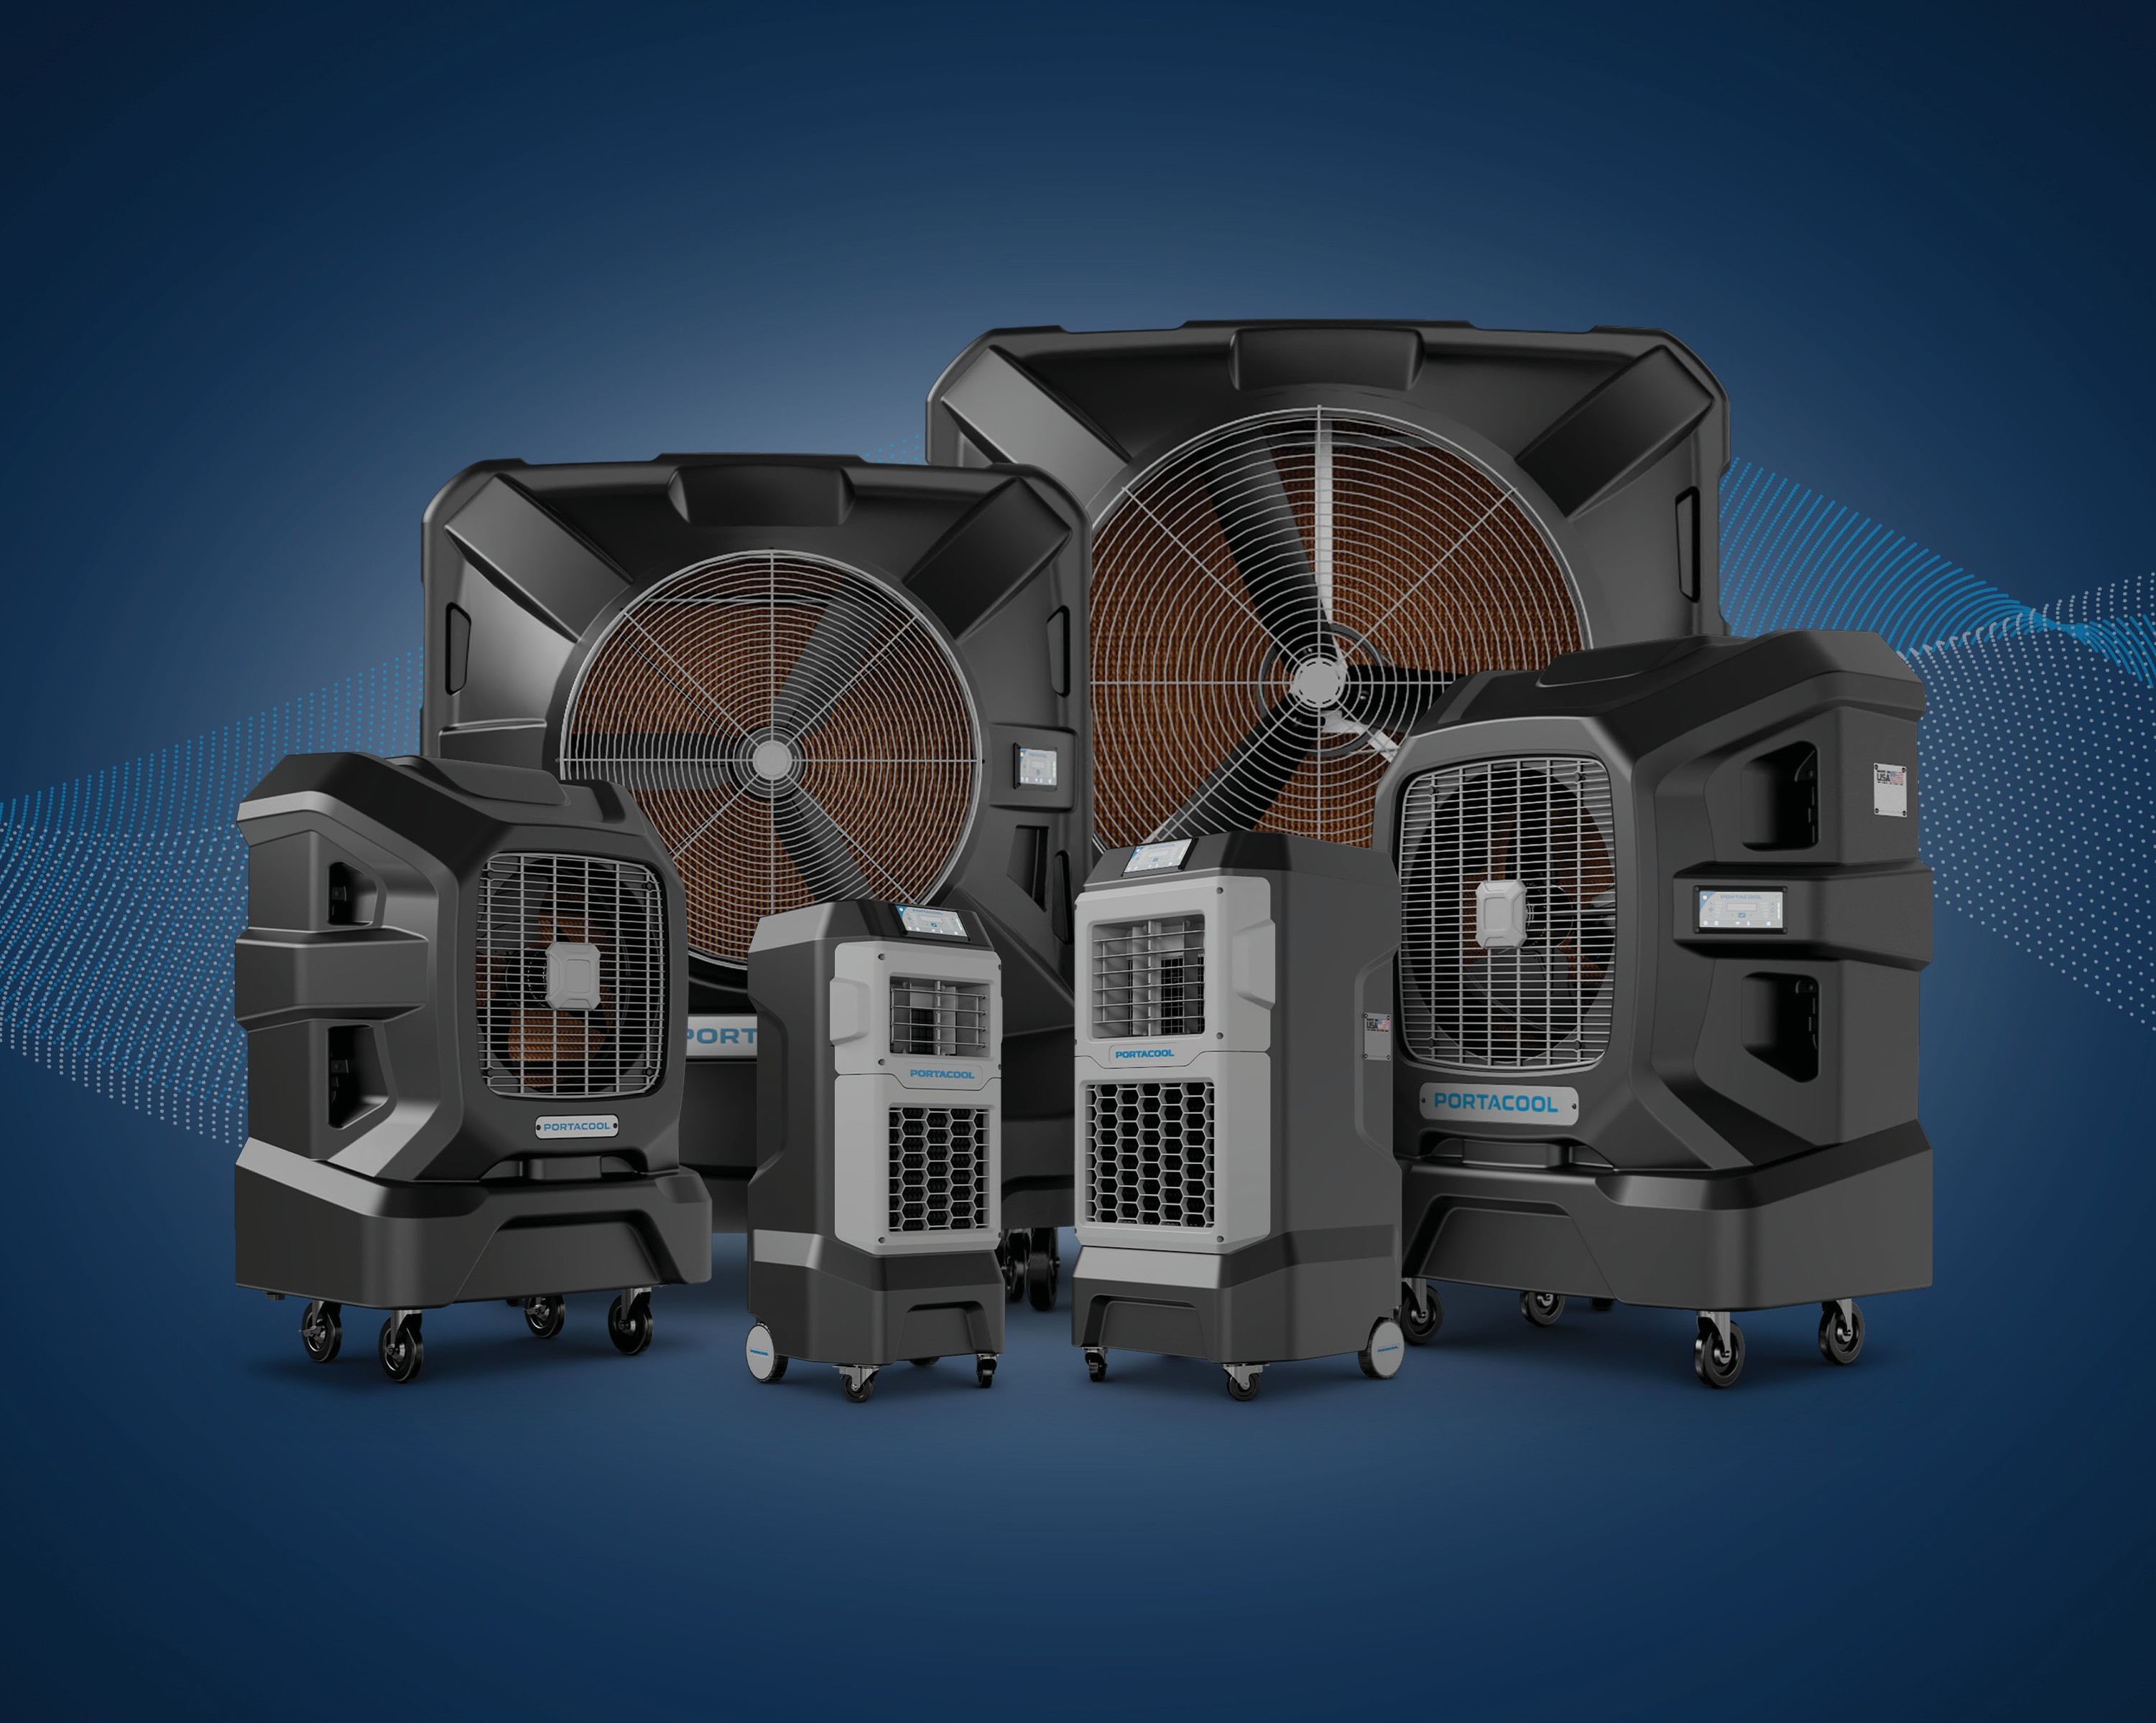

Slide 3

WELCOME
THE PORTACOOL BRAND GUIDE
The Portacool Brand Guide is your roadmap to understanding and expressing the essence of our brand. Portacool isn’t just about cooling—it’s about power, reliability, and innovation. For more than 30 years, we’ve been the industry leader in evaporative cooling solutions, helping hardworking people stay cool in the most challenging environments. This guide defines who we are, what we stand for, and how we communicate—ensuring that every message, design, and interaction reflects the strength and integrity of the Portacool brand.
Use this guide as your blueprint for consistency and impact. Whether you’re crafting a marketing campaign, designing packaging, or engaging with customers, this document provides the standards and inspiration to maintain our brand’s clarity and credibility. By staying true to these guidelines, we reinforce Portacool’s reputation as the trusted leader in cooling solutions - so let’s get to work and keep the world cool!
Robert Deraco
Chief Marketing Officer Portacool rderaco@synapseresults.com
©2025 Portacool LLC and Synapse Marketing Solutions. All rights reserved.

Slide 4
TABLE OF CONTENTS
INTRODUCTION ................................................................................................................................................................................................................5
BRAND IDENTITY ........................................................................................................................................................................................................... 6
WEB IMAGERY & DESIGN PRINCIPLES ................................................................................................................................................18
PRODUCT & POSITIONING...............................................................................................................................................................................35
APPLICATION & BRAND PLACEMENT................................................................................................................................................. 47
APPROVED ASSETS & RESOURCES .....................................................................................................................................................53
BRAND MESSAGING ................................................................................................................................................................................................55

Slide 5
INTRODUCTION
THE PORTACOOL BRAND GUIDE
The Portacool Brand Guide serves as the definitive resource for maintaining brand consistency, clarity, and impact across all internal and external communications. As a leader in portable evaporative cooling, our brand is more than just a name—it’s a promise of quality, innovation, and reliability. This guide establishes clear standards for our brand voice, identity, messaging, and visual representation, ensuring that every interaction reinforces Portacool’s reputation and leadership in the industry.
Purpose and Usage Guidelines
A strong and recognizable brand is built on consistency, trust, and authenticity. This guide provides the foundation for maintaining a unified presence across all touchpoints. It serves as a practical tool to:
n Align all communication efforts with Portacool’s established brand identity, reinforcing our values and market position. n Ensure a cohesive and compelling brand story across platforms, from marketing materials to customer interactions. n Maintain professionalism, credibility, and authority in all written and visual content.
n Empower employees, partners, and agencies with clear guidelines to accurately represent the Portacool brand.
By following these guidelines, we strengthen Portacool’s identity, enhance brand recognition, and build lasting trust with our customers and stakeholders.

Slide 6
BRAND IDENTITY
IN THIS SECTION
ORIGIN & DESIGN BR AND COLORS
LOGO USAGE & VARIATIONS BACKGROUNDS & TE X TURES LOGO CLE AR SPACE & MINIMUM SIZES T YPOGR APH Y
ADDITIONAL IDENTITIES CLE AR SPACE

Slide 7
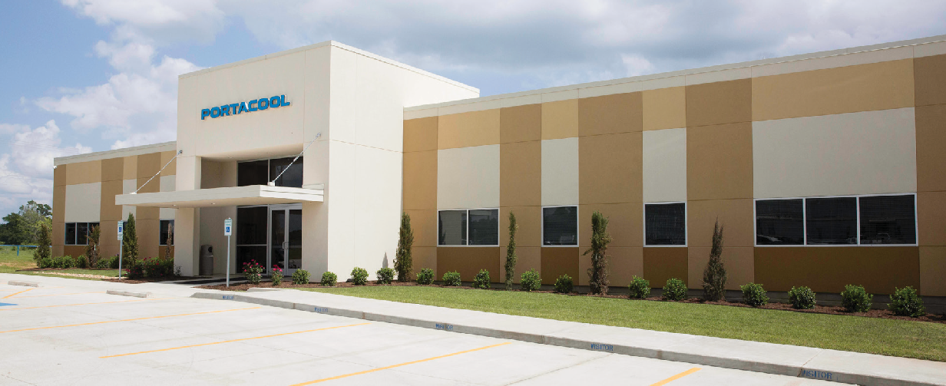

BR AND IDENTIT Y
ORIGIN & DESIGN
The Portacool logo was distinctly designed to express dynamics, precision, and a broad technical expertise. The logo has been registered for exclusive use with Portacool print and electronic advertising, as well as on Portacool products. The same form of the logo has been registered for use on all mediums. Portacool uses a bold blue tone as the brand color to signify quality, comfort, safety, and productivity.
Altering the Portacool logo in any way is prohibited. The logo should be reproduced in permitted brand colors as often as technically possible.
Neither the Portacool logo, tagline, or Made in USA mark should ever be translated out of English.

Slide 8
BR AND IDENTIT Y
LOGO USAGE & VARIATIONS
Primary Logo
The primary Portacool logo, also known as the Portacool wordmark, must only be used in the approved color combinations outlined in this guide (see examples below). The “Midnight Mesa” variant may be used when the primary Portacool blue lacks sufficient contrast in one-color applications, serving as an alternative to black, (for more information about brand colors, see page 11). The wordmark should not be placed on highly patterned backgrounds or photographs that compromise readability. Ensure the background provides sufficient contrast for clear visibility. The wordmark must not be altered in any way, including changes to typography, added effects such as drop shadows or underlines, or any other modifications.

Slide 9
BR AND IDENTIT Y
LOGO CLEAR SPACE & MINIMUM SIZES
Primary Logo Clear Space
To maintain the integrity and visibility of the Portacool wordmark, a clear space equal to its vertical height must be maintained around it in all applications. No other visual elements may encroach upon this space. Additionally, the Portacool wordmark should always stand alone and must not be used inline within headlines, body copy, or other typography.
X |  | X
X
X |  | X
Primary Logo Size Variations
To ensure legibility and proper reproduction, the Portacool wordmark must not be scaled below the established minimum height. Maintaining this size standard preserves the brand’s clarity and visual impact across all applications. Always adhere to the specified dimensions to ensure readability in both digital and print formats.
Minimum Screen Height - 20px
Minimum Print Height - 0.1875” or 3/16”

Slide 10


BR AND IDENTIT Y
ADDITIONAL IDENTITIES CLEAR SPACE
APEX Series
To ensure the integrity and visibility of the APEX Series wordmark, a clear space equal to its vertical height must be maintained around it in all applications. No other visual elements may encroach upon this space. Additionally, the APEX Series wordmark must always be used as a stand-alone element and should not be integrated inline within headlines, body copy, or other typography.
X |  | X
X
X |  | X
PRIMARY LOGO SIZE VARIATIONS
To ensure legibility and proper reproduction, the APEX Series wordmark must not be scaled below the established minimum height. Maintaining this size standard preserves the brand’s clarity and visual impact across all applications. Always adhere to the specified dimensions to ensure readability in both digital and print formats.
Minimum Screen Height - 20px
Minimum Print Height - 0.1875” or 3/16”

Slide 11
BR AND IDENTIT Y
BRAND COLORS
Portacool’s brand colors are a critical part of our visual identity, reinforcing recognition, consistency, and brand equity across all applications. These colors reflect our brand’s strength, reliability, and innovation, ensuring a cohesive look and feel in every communication channel.
To maintain brand integrity, always use the approved color palette provided in this guide. Consistent application across digital, print, and environmental design strengthens Portacool’s presence and reinforces our leadership in portable evaporative cooling.
Usage Guidelines
Portacool Blue
CMYK: 82-38-0-0
RGB: 5-133-200 HEX: 0085CA
Midnight Mesa
CMYK: 100-84-42-38
RGB: 16-45-79 HEX: 102E50
n Always use the specified color values (CMYK, RGB, HEX, and Pantone) to ensure accuracy across different media.
n Maintain proper contrast and legibility when placing text or logos over backgrounds.
n Avoid unapproved tints, gradients, or alterations that dilute brand consistency.
By adhering to these guidelines, we create a strong, unified brand experience that is instantly recognizable and reflects Portacool’s commitment to quality and excellence.
Silver Spur
CMYK: 17-11-8-0
RGB: 209-214-221 HEX: CFD5DC
Iron Horse
CMYK: 37-24-18-0
RGB: 163-175-189 HEX: A3AFBD
Texas Night Sky
CMYK: 89-77-55-72
RGB: 4-20-37
HEX: 041425
Golden Prairie
CMYK: 0-22-100-0
RGB: 255-198-0 HEX: FFC600

Slide 12
BR AND IDENTIT Y
BACKGROUNDS & TEXTURES
The Portacool Airstream Graphic
The Portacool airstream graphic is a key visual element that enhances brand storytelling and reinforces the impact of our cooling technology. It may be incorporated into imagery whenever a Portacool product is featured in lifestyle photography or composite conceptual art.
Additionally, the airstream graphic can be used as an accent or design element to add visual interest. When not integrated into photography or conceptual compositions, it should be placed on a solid brand color background to maintain consistency and clarity. Proper usage of this graphic strengthens brand recognition and visually communicates the power of Portacool’s cooling solutions.

Slide 13
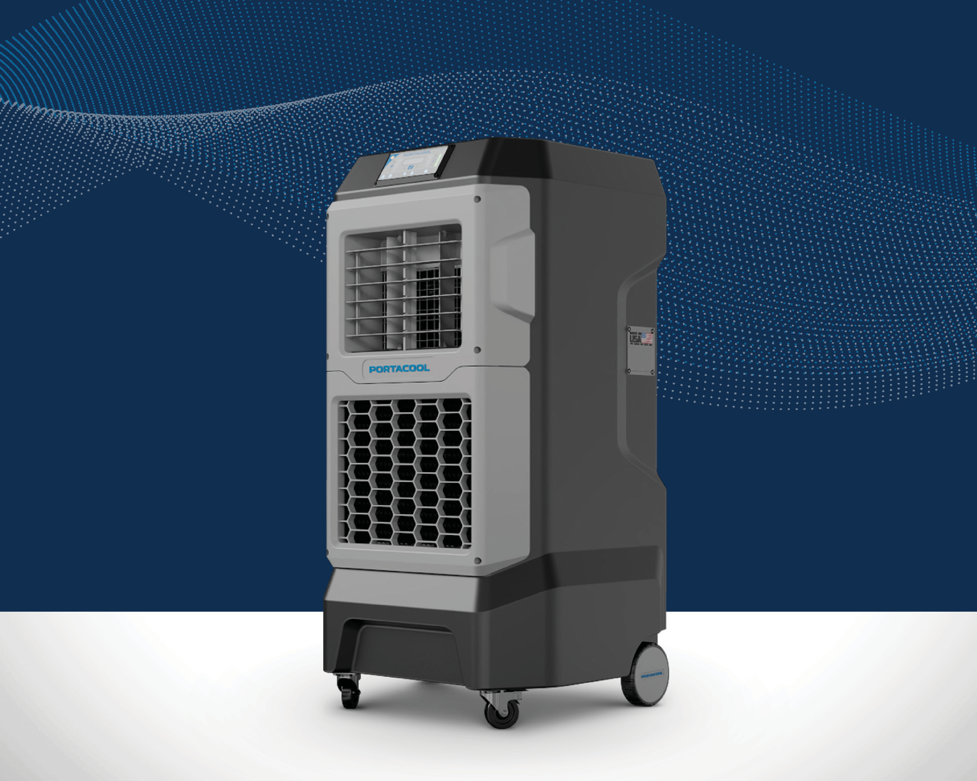

Slide 14
BR AND IDENTIT Y
TYPOGRAPHY
Primary Typeface
Portacool’s official corporate typeface is Normalidad Text, chosen for its modern, clean, and highly legible design. This typeface ensures a consistent and professional appearance across all brand communications while maintaining readability and impact. To accommodate various design needs, the Normalidad type family includes multiple variations.
NORMALIDAD TEXT
The standard typeface for body copy, general communications, and most brand applications.
Normalidad Text Regular
ABCDEFGHIJKLMNOPQRSTUVWXYZ
abcdefghijklmnopqrstuvwxyz 0123456789
Normalidad Text Medium
ABCDEFGHIJKLMNOPQRSTUVWXYZ
abcdefghijklmnopqrstuvwxyz 0123456789
Normalidad Text Bold
ABCDEFGHIJKLMNOPQRSTUVWXYZ
abcdefghijklmnopqrstuvwxyz 0123456789
NORMALIDAD COMPACT
Ideal for space-constrained applications such as packaging, labels, or small digital layouts where readability must be preserved in a tighter space.
Normalidad Compact Regular
ABCDEFGHIJKLMNOPQRSTUVWXYZ
abcdefghijklmnopqrstuvwxyz 0123456789
Normalidad Compact Medium
ABCDEFGHIJKLMNOPQRSTUVWXYZ
abcdefghijklmnopqrstuvwxyz 0123456789
Normalidad Compact Bold
ABCDEFGHIJKLMNOPQRSTUVWXYZ
abcdefghijklmnopqrstuvwxyz 0123456789

Slide 15
BR AND IDENTIT Y
TYPOGRAPHY
Primary Typeface (Continued)
NORMALIDAD WIDE
Best suited for headings, subheadings, or instances where a bold and authoritative presence is needed without overwhelming the design.
Normalidad Wide Regular
ABCDEFGHIJKLMNOPQRSTUVWXYZ
abcdefghijklmnopqrstuvwxyz 0123456789
Normalidad Wide Medium
ABCDEFGHIJKLMNOPQRSTUVWXYZ
abcdefghijklmnopqrstuvwxyz 0123456789
Normalidad Wide Bold
ABCDEFGHIJKLMNOPQRSTUVWXYZ
abcdefghijklmnopqrstuvwxyz 0123456789
NORMALIDAD EXTENDED
Used for high-impact statements, display text, or key brand messaging where a strong, expansive typographic presence enhances visibility.
ABCDEFGHIJKLMNOPQRSTUVWXYZ
abcdefghijklmnopqrstuvwxyz 0123456789
Normalidad Extended Regular
ABCDEFGHIJKLMNOPQRSTUVWXYZ
abcdefghijklmnopqrstuvwxyz 0123456789
Normalidad Extended Medium
ABCDEFGHIJKLMNOPQRSTUVWXYZ
abcdefghijklmnopqrstuvwxyz 0123456789
Normalidad Extended Bold

Slide 16
BR AND IDENTIT Y
TYPOGRAPHY
Alternative Typeface
When the primary typeface, Normalidad Text, is unavailable or incompatible with specific software, the approved alternative typeface, Inter, may be used. This substitution should be made sparingly and only after all efforts to use the primary typeface have been exhausted.
While Inter maintains a clean and modern aesthetic that aligns with the Portacool brand, it should never replace Normalidad Text in standard applications where the primary font is accessible. Consistent use of Normalidad ensures a cohesive brand identity across all communications.
INTER
Inter Light
ABCDEFGHIJKLMNOPQRSTUVWXYZ
abcdefghijklmnopqrstuvwxyz 0123456789
Inter Regular
ABCDEFGHIJKLMNOPQRSTUVWXYZ
abcdefghijklmnopqrstuvwxyz 0123456789
Inter Bold
ABCDEFGHIJKLMNOPQRSTUVWXYZ
abcdefghijklmnopqrstuvwxyz 0123456789
Inter Extra Bold
ABCDEFGHIJKLMNOPQRSTUVWXYZ
abcdefghijklmnopqrstuvwxyz 0123456789
Inter Black
ABCDEFGHIJKLMNOPQRSTUVWXYZ
abcdefghijklmnopqrstuvwxyz 0123456789

Slide 17
BR AND IDENTIT Y
TYPOGRAPHY
Typeface Styling
Consistent typography is essential for maintaining a strong and cohesive brand identity. The way our typefaces are styled— through hierarchy, weight, and spacing—ensures clarity, professionalism, and visual impact across all communications. This section provides guidance on how Normalidad Text and its variations should be used together in different sizes and styles to create a balanced and effective typographic system. By following these guidelines, we reinforce readability and brand recognition across all platforms.
SUPERHEAD - Normalidad Text Bold - 11pt Tracking +130
PE A K C O O L ING , IN TE L L I G E N T D ES I G N
Meet the APEX Series
The Pinnacle of Portable Evaporative Cooling Technology
HEADLINE - Normalidad Text Bold - 30pt
SUB HEAD - Normalidad Text Bold - 14pt
The Portacool APEX™ Series is designed to harness the natural process of evaporation to reduce air temperature in places where traditional fans and air conditioning fail to work, indoors or out, delivering significant cooling relief even in humid climates. Equipped with advanced features, including CoolSync™ Technology, easy-to-use controls, and enhanced airflow capabilities, the APEX Series is built to tackle extreme heat and create a comfortable, productive workspace. With the APEX Series, Portacool continues to set the standard in portable cooling solutions, ensuring peak performance in challenging conditions from home and husbandry to commercial and industrial applications.
BODY - Normalidad Compact Regular - 10pt In line hyperlinks - Portacool Blue
CTA - Normalidad Text Bold - 12pt
LEARN MORE

Slide 18
WEB IMAGERY & DESIGN PRINCIPLES
IN THIS SECTION
GENER AL IMAGERY GUIDELINES WEB & PRINT USAGE GUIDELINES LIFEST YLE VS . PRODUC T PHOTOGR APH Y USE OF OVERL AYS & SPOTLIGHT S
COMPOSITE & STAGED IMAGERY RULES L AYOUT STRUC TURE & IMAGERY ST YLE

Slide 19
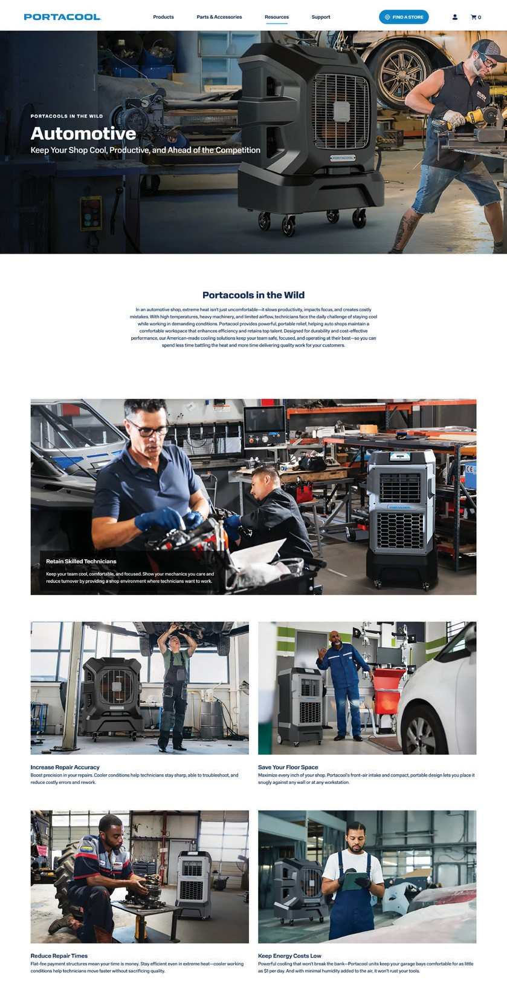
WEB IMAGERY & DESIGN PRINCIPLES
WEB IMAGERY & DESIGN PRINCIPLES
Portacool’s digital presence should reflect the same strength, clarity, and professionalism as our physical branding. Our web imagery and design principles ensure a visually cohesive and engaging user experience that communicates innovation, reliability, and expertise.
Imagery Guidelines
n Use high-quality, dynamic imagery that showcases Portacool products in real-world environments.
n Prioritize authentic lifestyle photography that highlights the benefits of our cooling solutions in action.
n Ensure consistent lighting, composition, and color grading to maintain brand cohesion.
n Avoid using cluttered, overly edited, or low-resolution images that diminish the brand’s professionalism.
Design Principles
n Maintain a clean, structured layout that prioritizes usability and clear messaging.
n Utilize the brand color palette effectively to create a visually harmonious experience. n Implement consistent typography hierarchy to improve readability and engagement. n Ensure all buttons, navigation, and calls-to-action are intuitive and user-friendly.
n Design with mobile responsiveness in mind, ensuring a seamless experience across all devices.
By following these principles, our digital presence remains strong, recognizable, and reflective of Portacool’s commitment to excellence and innovation.
Example of web imagery

Slide 20
WEB IMAGERY & DESIGN PRINCIPLES
GENERAL IMAGERY GUIDELINES
Portacool imagery should be vivid, high-quality, and clear, ensuring a strong visual impact while effectively communicating the value of our products. Every image must prominently feature a Portacool cooler, a key product feature, or a clear benefit, reinforcing our brand’s positioning as the leader in portable evaporative cooling.
Key Guidelines
n Images should showcase either the entire Portacool product line or focus on a specific model in a way that highlights its functionality and advantages.
n The product must be clearly visible and placed prominently within the composition to maximize recognition and impact.
n When targeting a specific market or industry, feature the models best suited for that application, ensuring relevance to the audience.
n It is acceptable to present a single product from one angle or display multiple products from varying angles to provide a comprehensive view.
n Whenever possible, include labels or identifiers for the product or series being shown to educate viewers on the recommended model for their needs.
By adhering to these guidelines, our imagery remains consistent, informative, and engaging, helping customers quickly understand the benefits of Portacool’s innovative cooling solutions.

Slide 21
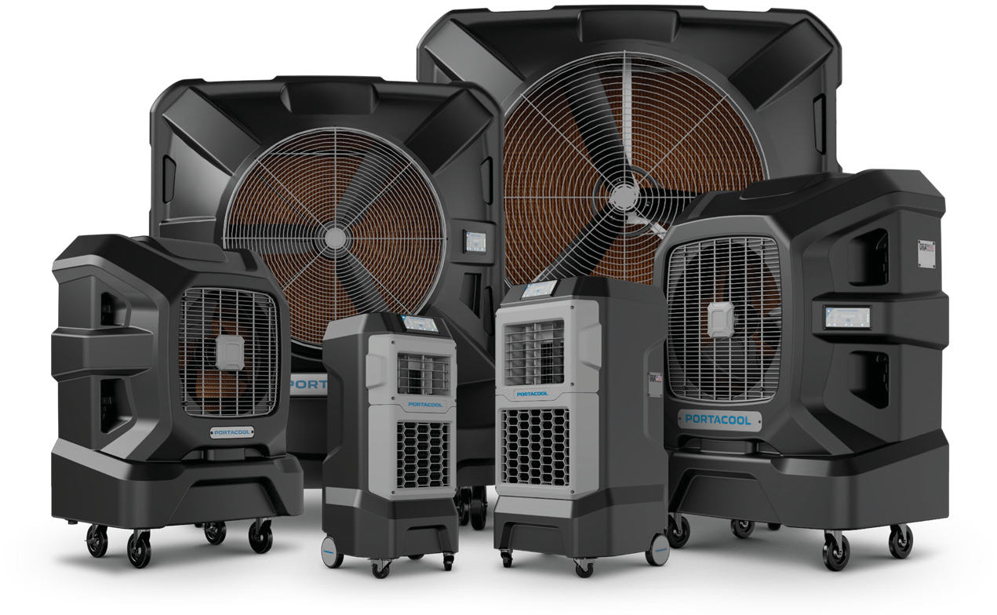
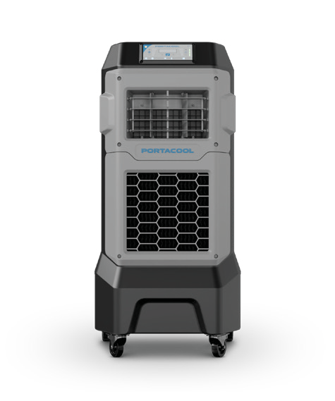
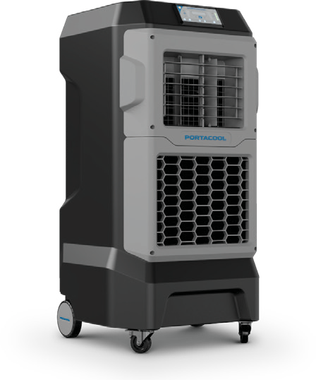
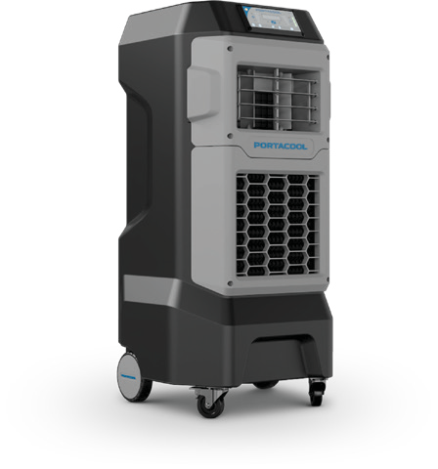
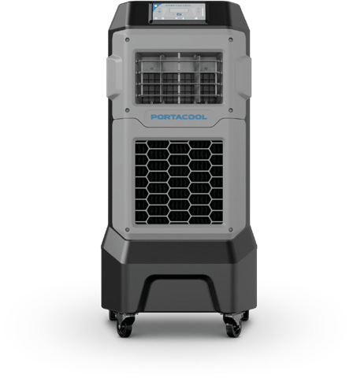
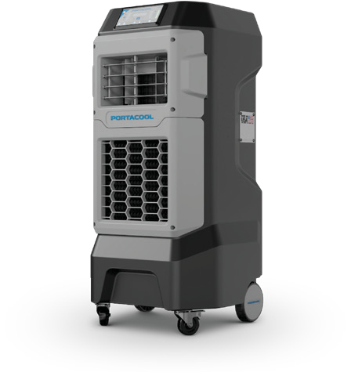
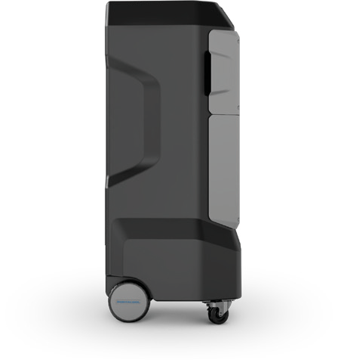
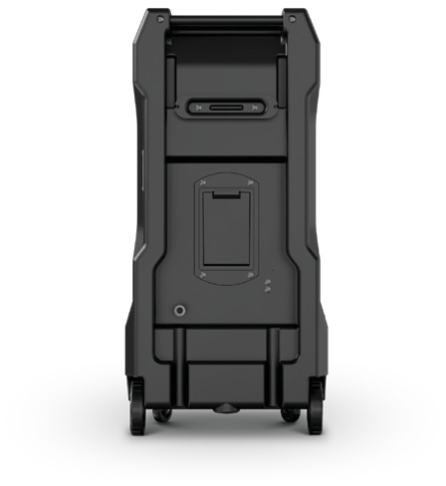
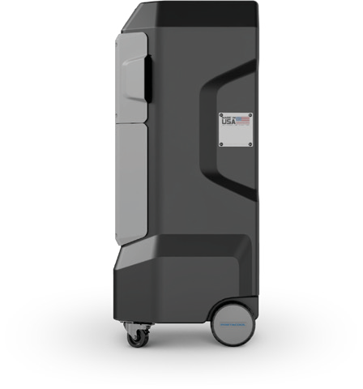
WEB IMAGERY & DESIGN PRINCIPLES
APEX 500 & 700
APEX 700
APEX SERIES
Examples of product labeling
Examples of product series labeling
Right Facing
Front
Left Facing
Right
Back
Left
Examples of most common product angles
Examples of less common product angles

Slide 22
WEB IMAGERY & DESIGN PRINCIPLES
GENERAL IMAGERY GUIDELINES
Product Imagery on Web
High-quality product imagery is essential for effectively showcasing Portacool’s cooling solutions online. Every image should be clear, professional, and strategically positioned to highlight key features and benefits.
Product Imagery on Web
n Use high-resolution images that accurately represent the product’s design, materials, and components.
n Maintain consistent lighting, angles, and backgrounds to create a cohesive and polished look across all web pages. n Incorporate callouts or zoomed-in views when necessary to emphasize important product features and advantages. n Display products in real-world settings whenever possible to demonstrate their effectiveness and scale.
n Ensure images are optimized for mobile devices to maintain quality and clarity across all screen sizes.
By adhering to these guidelines, Portacool’s product imagery will provide a strong, professional online presence that enhances customer confidence and supports informed purchasing decisions.

Slide 23
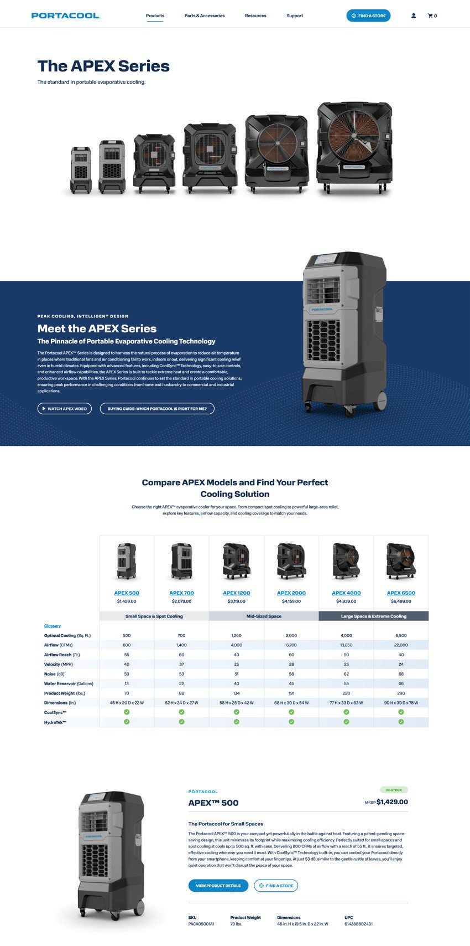
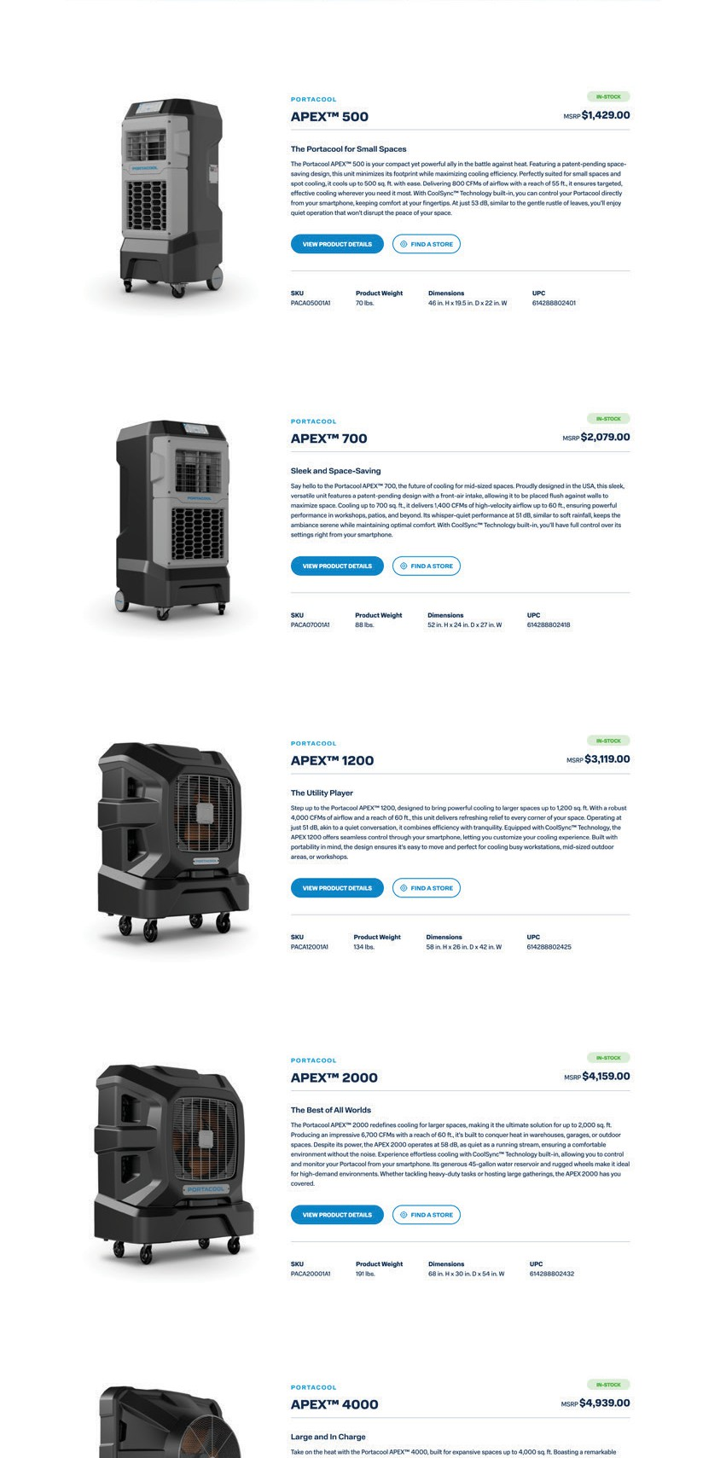

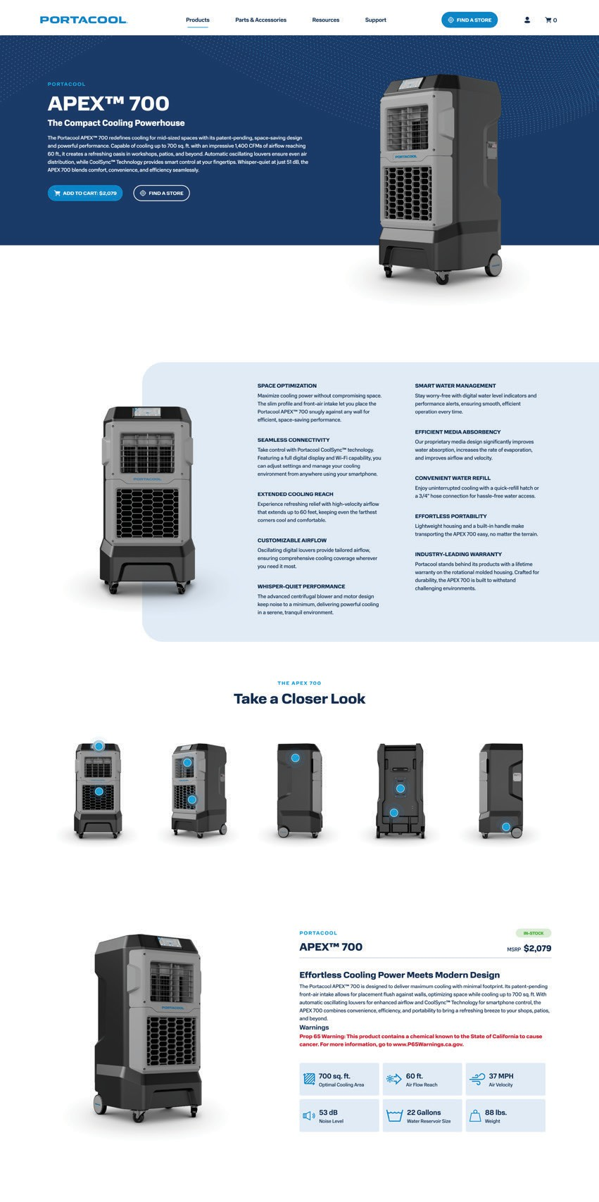
WEB IMAGERY & DESIGN PRINCIPLES
Examples of product imagery on the Web

Slide 24

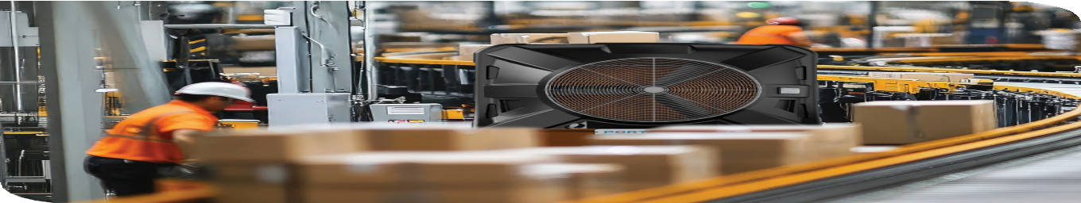
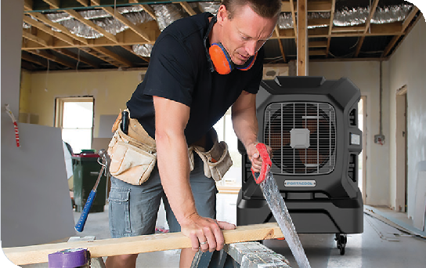
WEB IMAGERY & DESIGN PRINCIPLES
LIFESTYLE VS. PRODUCTION PHOTOGRAPHY
Both styles of photography serve distinct purposes within brand communication. A balanced mix of both ensures a compelling visual identity that resonates with customers across different platforms.
Lifestyle Photography
Lifestyle photography captures Portacool products in real-world settings, demonstrating their functionality in everyday use. These images create an emotional connection by showcasing the product in action, often featuring people interacting with it naturally and authentically.
Key Characteristics
n Showcases the product in a practical, real-life environment.
n Evokes emotions and tells a compelling story.
n Features models or customers using the product.
n Commonly used in advertisements, social media, and website banners.
n Highlights experience and usability rather than just the product itself.
Best Practices
n Use natural lighting and candid shots to enhance authenticity.
n Keep the product as the focal point while integrating it seamlessly into the scene.
n Maintain consistency in brand colors, styling, and tone to reinforce brand identity.
By following these guidelines, lifestyle photography strengthens Portacool’s brand presence, making our cooling solutions feel relatable and essential in everyday settings.

Slide 25
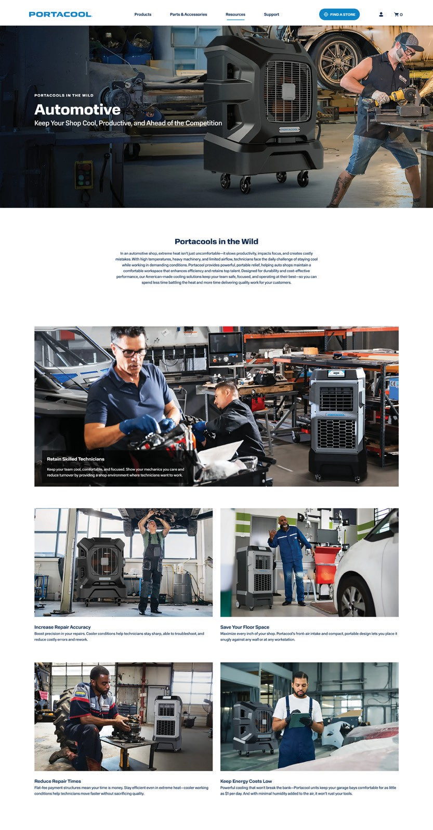
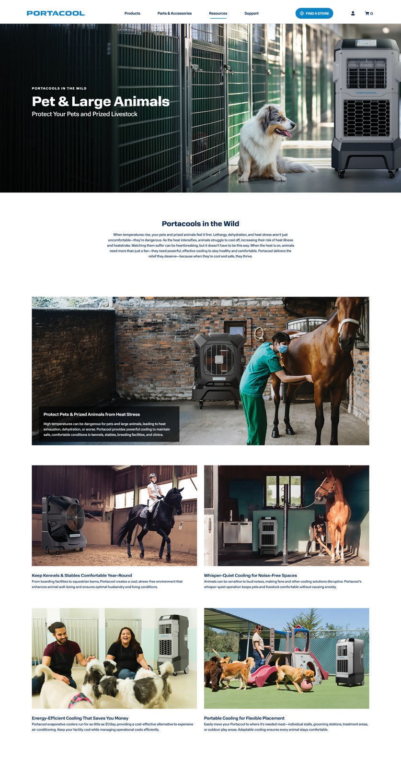
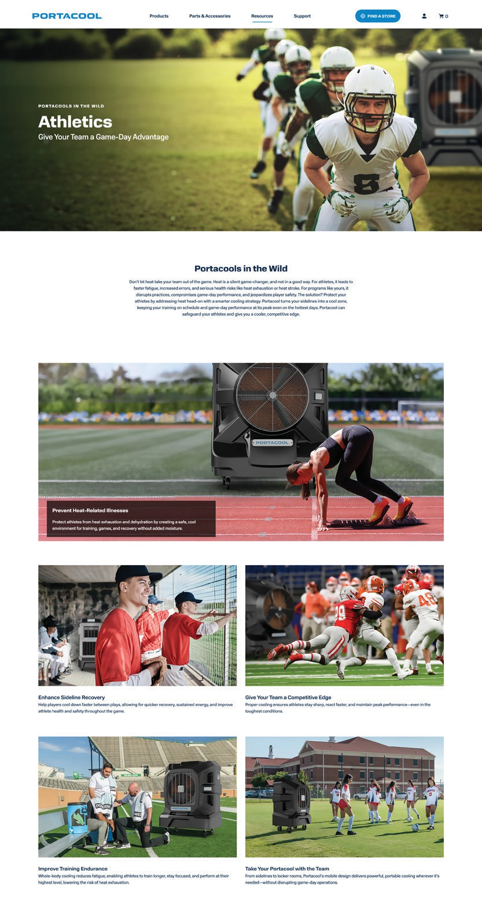
WEB IMAGERY & DESIGN PRINCIPLES
Examples of lifestyle photography on the Web

Slide 26
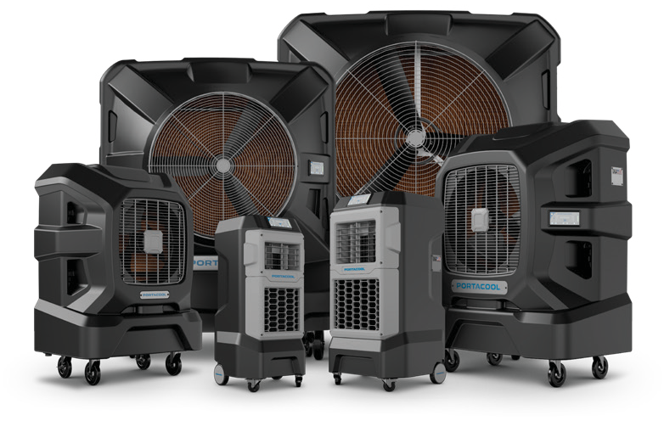



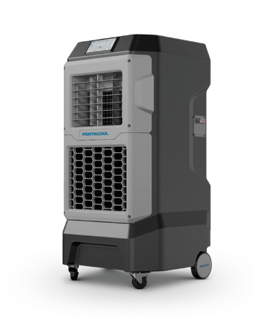
WEB IMAGERY & DESIGN PRINCIPLES
LIFESTYLE VS. PRODUCTION PHOTOGRAPHY
Production Photography
Production photography is designed to showcase Portacool products with clarity and precision, often using a clean, neutral background. The focus is on highlighting design, features, and details, making these images ideal for e-commerce, catalogs, and product listings.
Key Characteristics
n Captures the product without distractions.
n Typically shot in a studio with controlled lighting.
n Uses clean, neutral backgrounds (often blue, white, or gray).
APEX SERIES
n Emphasizes product details, materials, and textures.
n Commonly used in e-commerce, brochures, and packaging.
Best Practices
n Use high-resolution images to ensure sharpness and accuracy.
n Maintain consistent angles and lighting across all product images for a cohesive look.
n Avoid harsh shadows or reflections that may obscure key product features.
By following these guidelines, production photography reinforces Portacool’s commitment to quality, providing customers with clear and accurate visuals that aid in purchasing decisions.
APEX SERIES
PORTACOOL
APEX™ 700
The Compact Cooling Powerhouse
The Portacool APEX™ 700 redefines cooling for mid-sized spaces with its powerful performance and sleek, compact design. Capable of cooling up to 700 sq ft with an impressive 1,400 CFMs of airflow reaching 60 ft, it’s perfect for creating a refreshing oasis in workshops, patios, and beyond. With whisper-quiet operation at just 51 dB and the smart control of CoolSync™ Technology, the APEX 700 blends comfort, convenience, and efficiency seamlessly. Rugged yet portable, it’s your go-to solution for reliable cooling wherever you need it.
ADD TO CART: $2,079 FIND A STORE

Slide 27
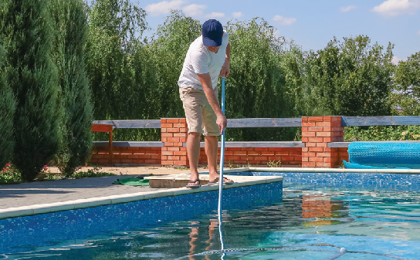
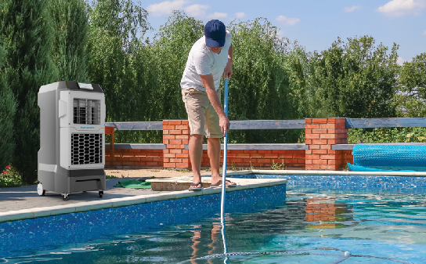
WEB IMAGERY & DESIGN PRINCIPLES
COMPOSITE & STAGED IMAGERY RULES
In some cases, it may not be practical to stage or photograph a Portacool unit in a real-world setting. When this occurs, composite imagery can be used to create realistic representations of the product in an appropriate environment. However, to maintain authenticity and professionalism, the following guidelines must be followed.
Composite Imagery
n Use a high-resolution base image, ensuring the environment aligns with the intended use of the cooler.
n Match the perspective of the background image with the cooler to maintain visual consistency—distortion of the cooler is not permitted.
n Ensure the scale of the cooler is accurate relative to its surroundings. Pay close attention to lighting, reflections, shadows, and contrast to create a natural, realistic final image.
Staged Imagery
n Choose a setting that appropriately reflects the cooler’s intended application.
n Position the cooler close to or directed toward the subject in the shot to clearly demonstrate its purpose.
n Ensure the subjects in the scene appear comfortable and natural, reinforcing the realistic usability of the product.
By adhering to these guidelines, composite and staged imagery will maintain credibility, ensuring Portacool’s products are presented in a way that is both authentic and visually compelling.
Example of original image
Example of composite image

Slide 28
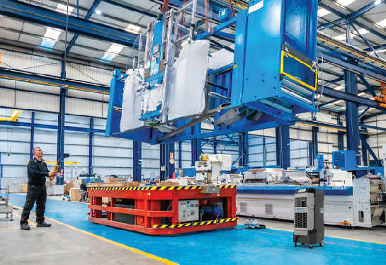
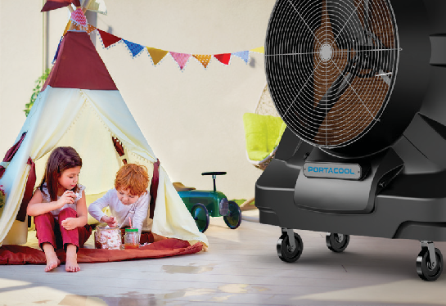
WEB IMAGERY & DESIGN PRINCIPLES
WEB & PRINT USAGE GUIDELINES
Composite & Staged Imagery
Composite images may be created for conceptual advertising when a real-world setting is impractical. Professionally staged photography may also be used to ensure high-quality, controlled visuals.
n Products should always be depicted in their intended environment to maintain authenticity and relevance.
n Portacool units should not be shown in environments unsuitable or inefficient for the specific model being featured.
n Conceptual imagery is an exception, allowing for dramatic comparisons, storytelling, or humorous exaggeration to enhance messaging.
By following these guidelines, all web and print imagery will maintain consistency, professionalism, and brand integrity while effectively communicating Portacool’s value.
Example of improper environment for APEX 500
Example of improper environment for APEX 6500

Slide 29
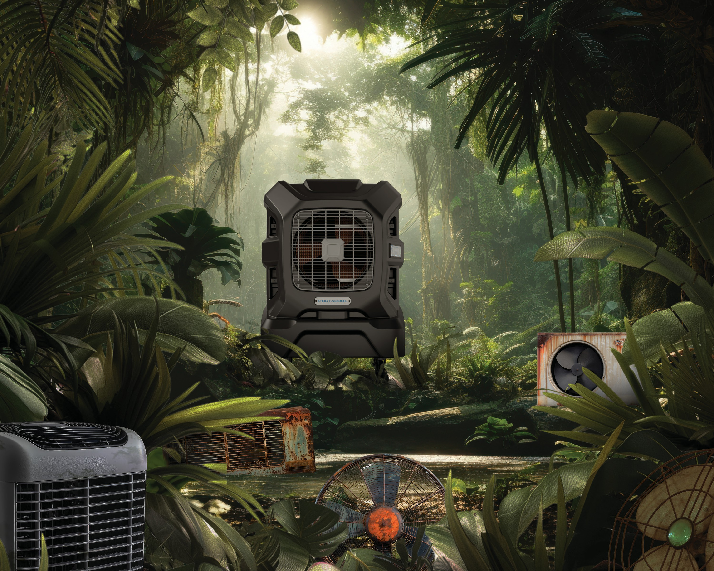

Slide 30
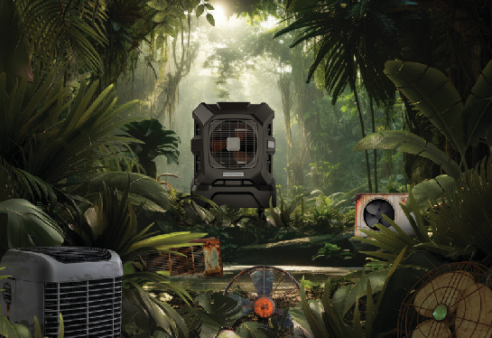
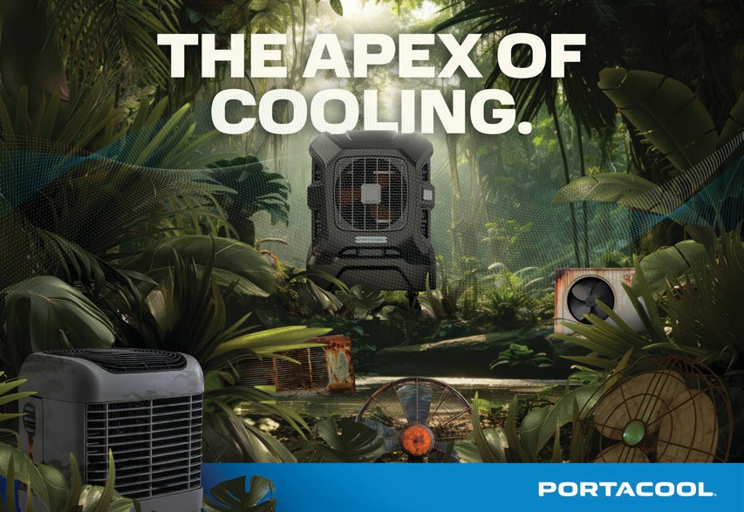
WEB IMAGERY & DESIGN PRINCIPLES
WEB & PRINT USAGE GUIDELINES
Web Imagery Guidelines
Web images should follow the same foundational guidelines as outlined above to maintain consistency and clarity across all digital platforms.
n When using lifestyle images, ensure that the subject and Portacool product remain unobstructed by bold headlines or body copy, preserving legibility and product visibility.
n Avoid overlays whenever possible. If size constraints require them, ensure that the Portacool product remains fully visible and unobstructed.
n Consider placing text on the Cool Blue or Cool Dark Blue background while keeping the product separate for better contrast and readability.
n The product may be fully contained within the blue background or extend beyond it at the top or bottom to create visual interest.
n Incorporate the Portacool Airstream graphic behind the product and apply a subtle spotlight glow to enhance depth and draw attention.
By following these guidelines, web imagery remains engaging, professional, and aligned with the Portacool brand identity.
Example of conceptual composite image
Example of conceptual composite image used with integrated headline and branding

Slide 31
WEB IMAGERY & DESIGN PRINCIPLES
WEB & PRINT USAGE GUIDELINES
Brand Placement
The Portacool logo must be included in all digital and print advertising to maintain brand consistency and recognition.
n The logo must not be placed over photos or patterns.
n It may only be used in its approved color variations:
u Full-color logo on a white background.
u Solid black logo on a white background.
u Reversed white logo on Cool Blue, Cool Dark Blue, or black backgrounds.
n Sufficient clear space must be maintained around the logo, as outlined in the Logo Clear Space section.
n The logo should be positioned below the message in the lower third of the ad, aligned to the far left, center, or far right, depending on the design.
n The company URL (portacool.com) must appear in all advertising materials, with additional contact information included if necessary.
By following these guidelines, Portacool’s brand remains visually consistent, professional, and easily recognizable across all web and print applications.
Example of color logo on white background
Example of reversed logo on “Portacool Blue” background

Slide 32
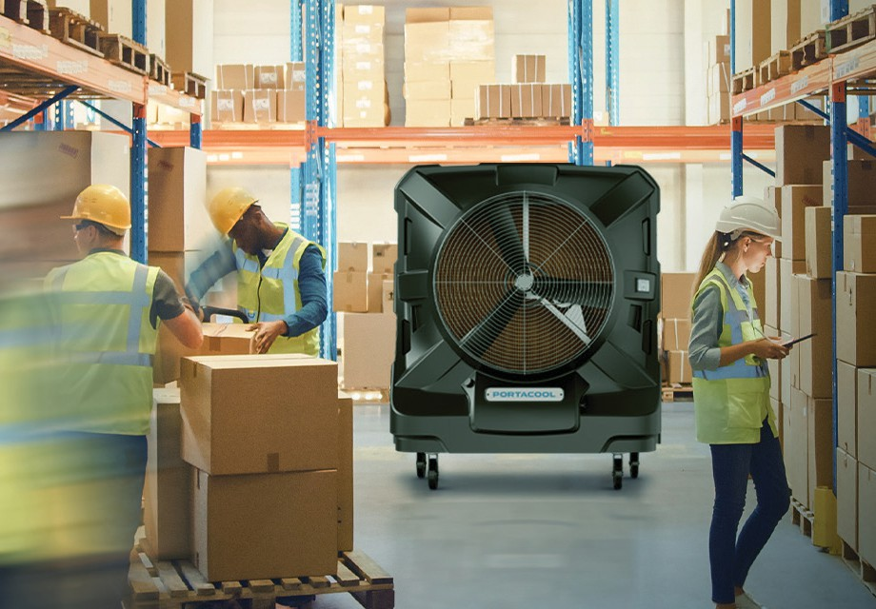

WEB IMAGERY & DESIGN PRINCIPLES
USE OF OVERLAYS & SPOTLIGHTS
To enhance the visual impact of lifestyle images, overlays are used to create a cohesive and polished look while reinforcing the cooling effect of Portacool products.
Cool Overlay
Applied to lifestyle images featuring coolers in use to emphasize the cooling effect.
n Uses the Portacool Blue primary color.
n Blending mode should be set to Soft Light.
n Opacity should be set to 40%.
n If the image temperature is already cool, reduce the overlay opacity as needed to prevent an overly saturated or “underwater” effect.
Example showing lifestyle product usage with airstream graphic and Cool Overlay
Warm Overlay
Applied to images that do not feature the product to contrast cooled and uncooled areas.
n Uses the Golden Prairie warm overlay color. n Blending mode should be set to Soft Light. n Opacity should be set to 40%.
n Designers may adjust the overlay to prevent the image from appearing overly warm.
By carefully applying overlays, images remain visually balanced, effectively differentiating cooled and uncooled environments while maintaining brand consistency.
Example of the same image with Warm Overlay to show a hot environment; notice the absence of Portacool unit and airstream graphic

Slide 33
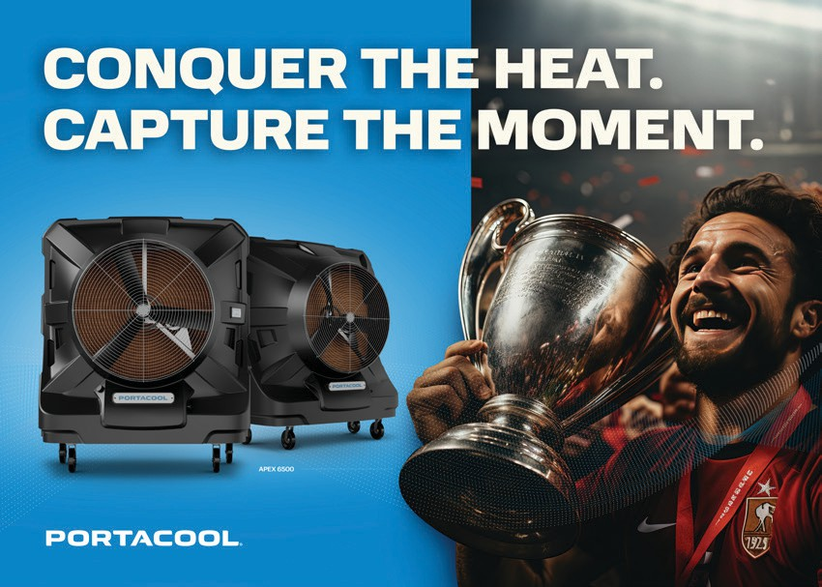
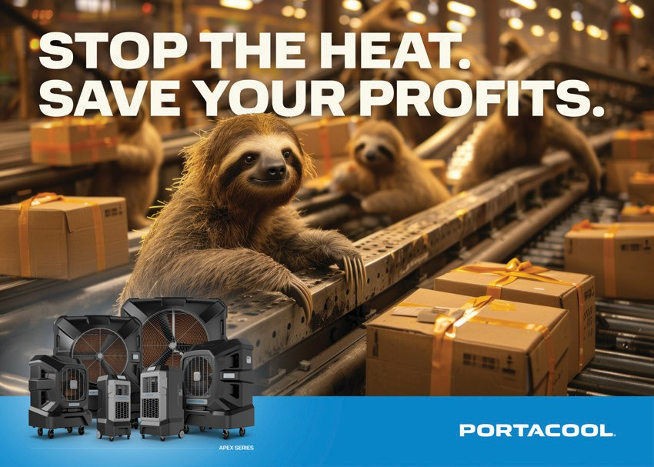


WEB IMAGERY & DESIGN PRINCIPLES
EXAMPLES: OVERLAYS & SPOTLIGHTS
The following examples illustrate the correct application of overlays and spotlights to enhance imagery while maintaining brand consistency.
Product contained within solid brand color with the use of airstream graphic and spotlight glow
No product or airstream graphic shown in image with the use of Warm Overlay; product shown on solid brand color with breakout and spotlight glow
APEX SERIES
APEX SERIES
Examples of featured labeled product line on solid Portacool Blue background with Portacool spotlight glow

Slide 34
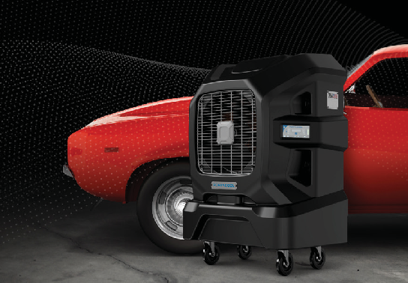

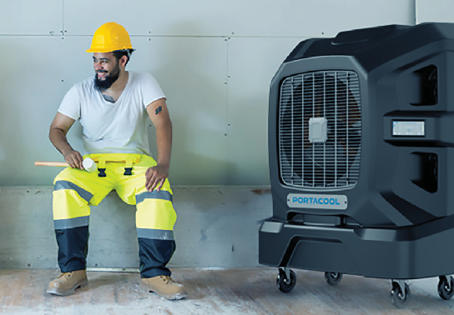

WEB IMAGERY & DESIGN PRINCIPLES
LAYOUT STRUCTURE & IMAGERY STYLE
A strong, cohesive layout and imagery style reinforce Portacool’s brand identity, ensuring all visual elements convey professionalism, innovation, and confidence.
Layout Structure
n Follow a clean, grid-based layout to create visual balance and organization.
n Use ample white space to maintain a premium and uncluttered aesthetic.
Imagery Style
n Portacool imagery should reflect authority, confidence, and innovation while remaining approachable and engaging.
n Utilize the Portacool Airstream graphic to enhance imagery and reinforce brand identity.
n Apply the Cool Overlay to lifestyle images to illustrate a cooler ambient temperature.
DO
Example use and placement of airstream graphic
Use high-quality images that align with Portacool’s professional and premium look.
Incorporate Portacool Airstream graphics where appropriate.
Apply the Cool Overlay on lifestyle images to emphasize cooling effects.
DO NOT
Use poorly cropped or low-resolution images.
Overcrowd layouts with excessive elements that disrupt clarity.
Place text or logos in a way that obstructs key imagery or reduces readability.
By adhering to these guidelines, all design materials will maintain a consistent, polished, and visually impactful brand presence.
Example use of Cool Overlay to illustrate cooler ambient temperature

Slide 35
PRODUCT & POSITIONING
IN THIS SECTION
K E Y PRODUC T FE ATURES & BENEFIT S
APE X SERIES OVERVIE W
COOL SYNC™ TECHNOLOGY H YDROTEK ™

Slide 36
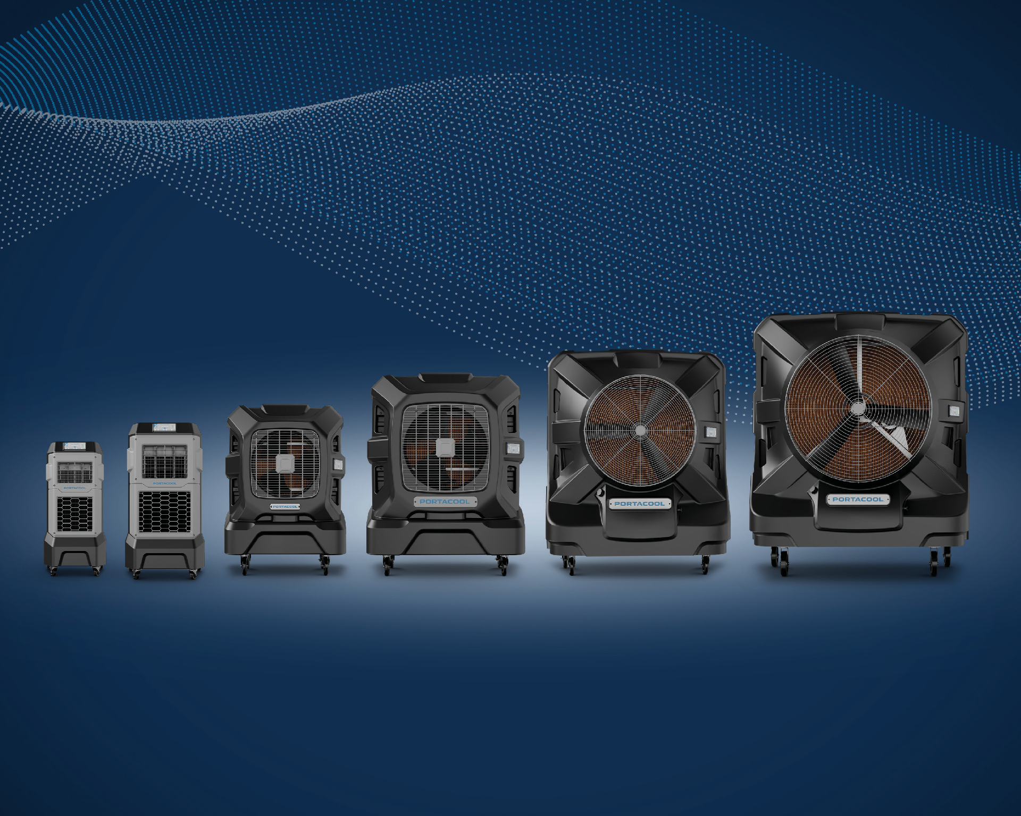


Slide 37
PRODUCT & POSITIONING
PRODUCT & POSITIONING
Portacool is committed to delivering innovative, high-performance cooling solutions that provide unmatched durability, efficiency, and ease of use. Our product lineup is designed to tackle extreme heat, improve air quality, and enhance comfort in demanding environments.
In This Section
Product & Positioning Guidelines
The following sections will explore Portacool’s cutting-edge technology and product features in greater detail, providing guidance on how to effectively communicate their value.
A consistent and strategic approach to product positioning ensures that Portacool’s key features and benefits are effectively communicated.
Portacool APEX™ Series
n Messaging should focus on real-world applications, making it clear how Portacool products solve problems, enhance productivity, and provide superior cooling performance.
The Portacool APEX™ Series represents the next generation of powerful, high-performance evaporative coolers. Designed for demanding environments, the APEX Series delivers significant temperature drops even in humid conditions. With enhanced airflow capabilities, rugged construction, and intuitive controls, these coolers provide reliable, long-lasting cooling solutions for industrial and commercial applications.
n Product descriptions should highlight the unique advantages that set Portacool apart from competitors. This includes emphasizing advanced technology, durable construction, and energy-efficient operation.
CoolSync™ Technology
n Clear, benefit-driven language should always be used, ensuring that customers understand how Portacool coolers improve working and living conditions.
CoolSync™ Technology is Portacool’s innovative smart cooling system, designed for seamless connectivity and remote control. Wi-Fi-enabled and fully integrated with a user-friendly app, CoolSync™ allows for real-time adjustments to fan speed, wind direction, water control, and scheduling from any mobile device. This technology enhances convenience and efficiency, giving users complete control over their cooling environment.
n Ease of use and reliability are essential components of the brand message. Products should be positioned as user-friendly, with intuitive controls, minimal maintenance requirements, and long- term durability.
HydroTek™ Evaporative Media
These key attributes reinforce Portacool’s reputation as a leader in evaporative cooling solutions.
HydroTek™ Evaporative Media is Portacool’s proprietary evaporative cooling media, engineered for maximum efficiency, better air quality, and reduced maintenance. Its advanced design increases water absorption, enhances airflow, and prevents mineral buildup, ensuring superior cooling performance. With durable materials and self-cleaning properties, HydroTek™ provides long-lasting, reliable operation in all Portacool products.
By following these guidelines, Portacool’s product positioning remains clear, compelling, and focused on delivering industry-leading cooling solutions.

Slide 38
PRODUCT & POSITIONING
KEY PRODUCT FEATURES & BENEFITS
Portacool Evaporative Coolers
Efficient & Effective: Lower the Temperature by as Much as 30°F for as Little as $1/Day
Portacool evaporative coolers are designed to deliver powerful, efficient, and reliable cooling in environments where traditional cooling methods fall short. The following positioning statements highlight the key features and benefits that set Portacool apart, demonstrating why it is the preferred solution for industries, workplaces, and outdoor spaces.
The evaporative cooling process is remarkably efficient, increasing humidity by only 1-2% while delivering substantial temperature reductions—all for as little as $1 per day. This makes Portacool a cost-effective and reliable cooling solution for large, partially enclosed, and outdoor spaces where traditional cooling methods may be impractical.
Innovative: Where Science Meets Superior Cooling
The actual temperature drop achieved depends on the relative humidity of the environment. In arid climates, Portacool coolers can reduce temperatures by 20–30°F, while in humid environments, a 10–15°F reduction is typical. This adaptability allows Portacool to provide consistent and effective cooling, even in challenging conditions.
Portacool’s advanced evaporative coolers harness the natural process of evaporation to reduce air temperature in places where traditional fans and air conditioning solutions fail to work. As water transforms into gas, high-energy particles and heat are released, causing a reduction in temperature. Portacool’s innovative technology amplifies this process, leveraging the science of evaporative cooling on a large scale to maintain a cool, comfortable environment - resulting from a temperature drop of up to 30°F.
Additional Features & Benefits
Portacool evaporative coolers are designed with advanced features that go beyond cooling, enhancing air quality, efficiency, and ease of use. Each unit includes an integrated air filter that helps reduce allergens, inhibit mildew growth, and improve overall air quality, making it especially beneficial for individuals with respiratory concerns.
High-Performing: Cooling Where Others Can’t Compete
The innovative science of evaporative cooling uses the natural cooling power of water to achieve significant temperature reductions with minimal energy consumption. With evaporative cooling, hot air is drawn into the cooler and directed through specially designed evaporative media that is continuously saturated with water. As the hot air passes through the media, water molecules evaporate, releasing energy and lowering the air temperature by as much as 30°F. A powerful fan then distributes this cooler, more comfortable air throughout the space, ensuring maximum coverage and relief.
A high-efficiency water pump ensures consistent water circulation, optimizing the evaporative cooling process while extending the lifespan of the HydroTek™ Evaporative Media. Additionally, select models feature CoolSync™ Technology, allowing for remote monitoring and control via a user-friendly app. This smart connectivity provides seamless adjustments to fan speed, wind direction, and scheduling, giving users greater flexibility and convenience - from their smartphone or mobile device.
Conversely, traditional fans simply circulate warm air without lowering the temperature, offering little relief in extreme heat. Air conditioners, while effective, require sealed environments, high energy consumption, and costly installation and maintenance, making them impractical for many industrial, commercial, and outdoor settings.
With these innovations, Portacool delivers powerful, efficient, and hassle-free cooling, ensuring a cool, safe, and comfortable environment in any setting. For these reasons and more, Portacool is the defacto standard in portable cooling.
Portacool’s evaporative coolers provide a cost-effective, energy-efficient solution that works in open-air and large spaces where traditional cooling methods fail. Compared to fans and air conditioners, Portacool is the superior choice when it comes to cooling.

Slide 39
PRODUCT & POSITIONING
THE PORTACOOL APEX™ SERIES
Peak Cooling, Built for the Toughest Environments
Leading our lineup is the Portacool APEX™ Series, a selection of high-performance evaporative coolers that combine cutting-edge technology with a robust, user-friendly design. Engineered for superior cooling relief, the APEX Series effectively reduces temperatures even in humid climates, achieving 10–13°F drops in hot and humid spaces and even greater cooling effects in arid environments—up to 30°F cooler!
Designed to withstand harsh conditions, the APEX Series features enhanced airflow capabilities and intuitive controls, making it the ideal solution for industrial, commercial, and demanding workspaces. With the APEX Series, Portacool continues to set the standard in portable cooling solutions, delivering peak performance, improved air quality, and enhanced comfort in the most challenging environments.
Innovative Design
The APEX 500 and APEX 700 models feature a patent-pending design that redefines portable evaporative cooling efficiency. Engineered with a vertically stacked internal structure, these models minimize their footprint while maximizing cooling power, making them ideal for space-conscious environments.
This innovative configuration strategically places the water reservoir, HydroTek™ Evaporative Media, and high-performance fan in a compact layout, allowing for seamless placement against walls without compromising airflow.
n Front-facing warm air intake and cool air discharge ensure optimal airflow and efficient cooling distribution.
n Wall-hugging profile allows for easy integration into tight workspaces without reducing performance.
n Whisper-quiet operation supports productivity while delivering powerful cooling.
n Advanced CoolSync™ Technology provides remote monitoring and control, ensuring precision cooling adjustments.
n Durable, American-made craftsmanship ensures long-lasting performance in the toughest conditions.
With its revolutionary design, advanced technology, and unmatched cooling power, the Portacool APEX™ Series is the future of portable evaporative cooling, delivering superior comfort and efficiency where it’s needed most.

Slide 40
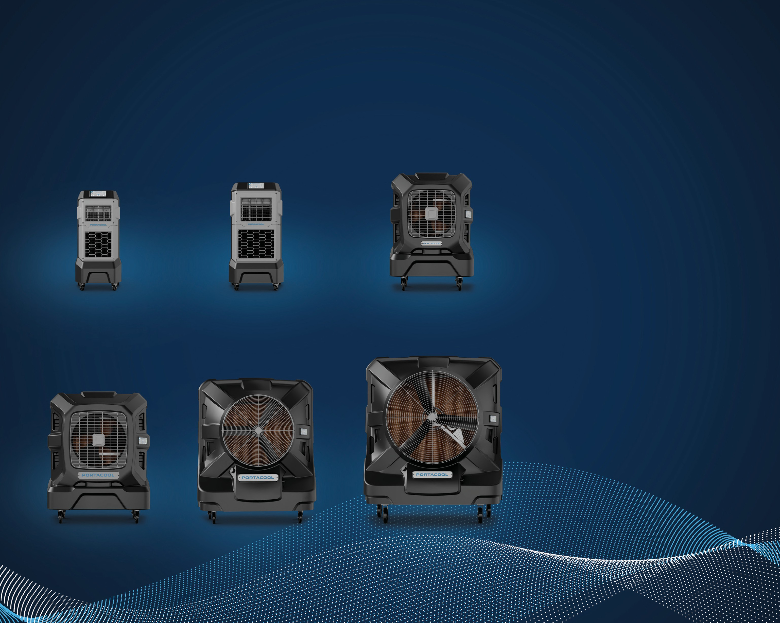
PRODUCT & POSITIONING
POSITIONING THE APEX SERIES
Selecting the right cooler starts with understanding the unique strengths of each model in the APEX Series. Designed for power, efficiency, and adaptability, each APEX cooler is engineered to meet specific cooling demands across a variety of environments. The following positioning statements provide quick, impactful descriptions that highlight the key advantages of each model, helping consumers identify the best solution for their needs at a glance.
APEX 500
APEX 700
APEX 1200
The Portacool for Small Spaces
Sleek and Space-Saving
The Utility Player
APEX 2000
APEX 4000
APEX 6500
The Best of All Worlds
Large and In Charge
Extreme Cooling for Large Spaces
PORTACOOL BRAND GUIDE 40

Slide 41
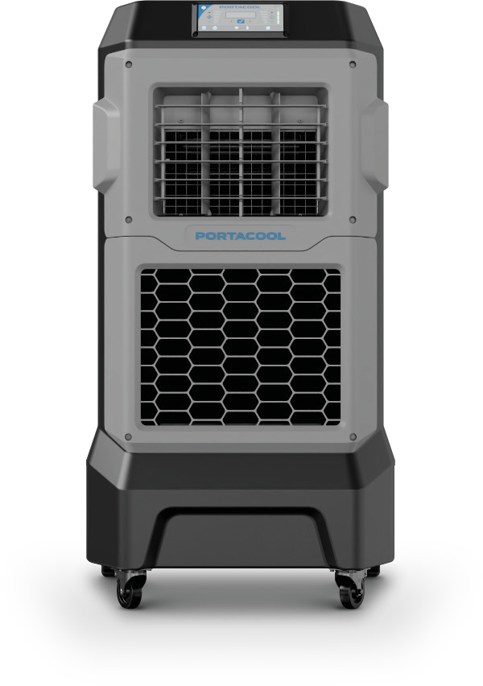


PRODUCT & POSITIONING
THE PORTACOOL APEX™ SERIES
Features & Benefits
The APEX Series is built to deliver powerful, efficient, and reliable cooling in the most demanding environments. Engineered with cutting-edge technology and user-friendly design, these coolers provide exceptional performance, durability, and convenience. This section outlines the key features and benefits that set the APEX Series apart, ensuring users get maximum cooling power with minimal effort.
Smart, Connected Cooling
Powered by CoolSync™ Technology, the APEX Series offers complete connectivity, featuring a digital display with Wi- Fi capability. Control your cooling environment remotely, set automatic shut-offs, and receive alerts for enhanced convenience and worry-free operation.
Rugged, Portable, and Smartly Designed
The APEX Series is engineered for versatility and durability. Featuring a built-in handle, lightweight rotational molded housing, and sturdy wheels, Portacools are easy to transport across any terrain, making them ideal for workspaces, outdoor areas, and industrial settings.
1
4
Quiet, Efficient, and Far-Reaching
With whisper-quiet performance and a space-saving, wall- hugging design, the advanced fan blade and motor deliver powerful cooling without disruptive noise or unnecessary floor space usage.
2
5
Digital Louver Control
APEX evaporative coolers are equipped with oscillating louvers for customized airflow, enabling precise and broad cooling coverage. With digital controls, you can adjust louvers to target specific areas and ensure maximum comfort across a wide space.
Superior Cooling and Air Quality
Built into every Portacool APEX™ unit, HydroTek™ evaporative media sets a new standard for cooling efficiency, durability, and air quality. Engineered with an expanded surface area and unique flute angles, HydroTek™ maximizes water absorption and airflow, delivering unparalleled cooling power. Crafted from high-grade cellulose fibers with specialty resins and UV-resistant edge-coat technology, HydroTek™ minimizes debris buildup and requires less maintenance, providing cleaner, healthier air for your space.
Smart Water Management
The Portacool APEX™ Series includes intelligent water level indicators and performance alerts, so you’re always in control. Refilling is simple with a hatch access point or a convenient 3/4” hose connection, ensuring uninterrupted cooling with minimal effort.
3
6
Industry-Leading Warranty
Portacool stands behind its products with a lifetime warranty on the rotational molded housing and a limited warranty on electrical components. Crafted for durability, the APEX Series is built to withstand challenging environments, providing reliable cooling that’s made to last.
7
7

Slide 42
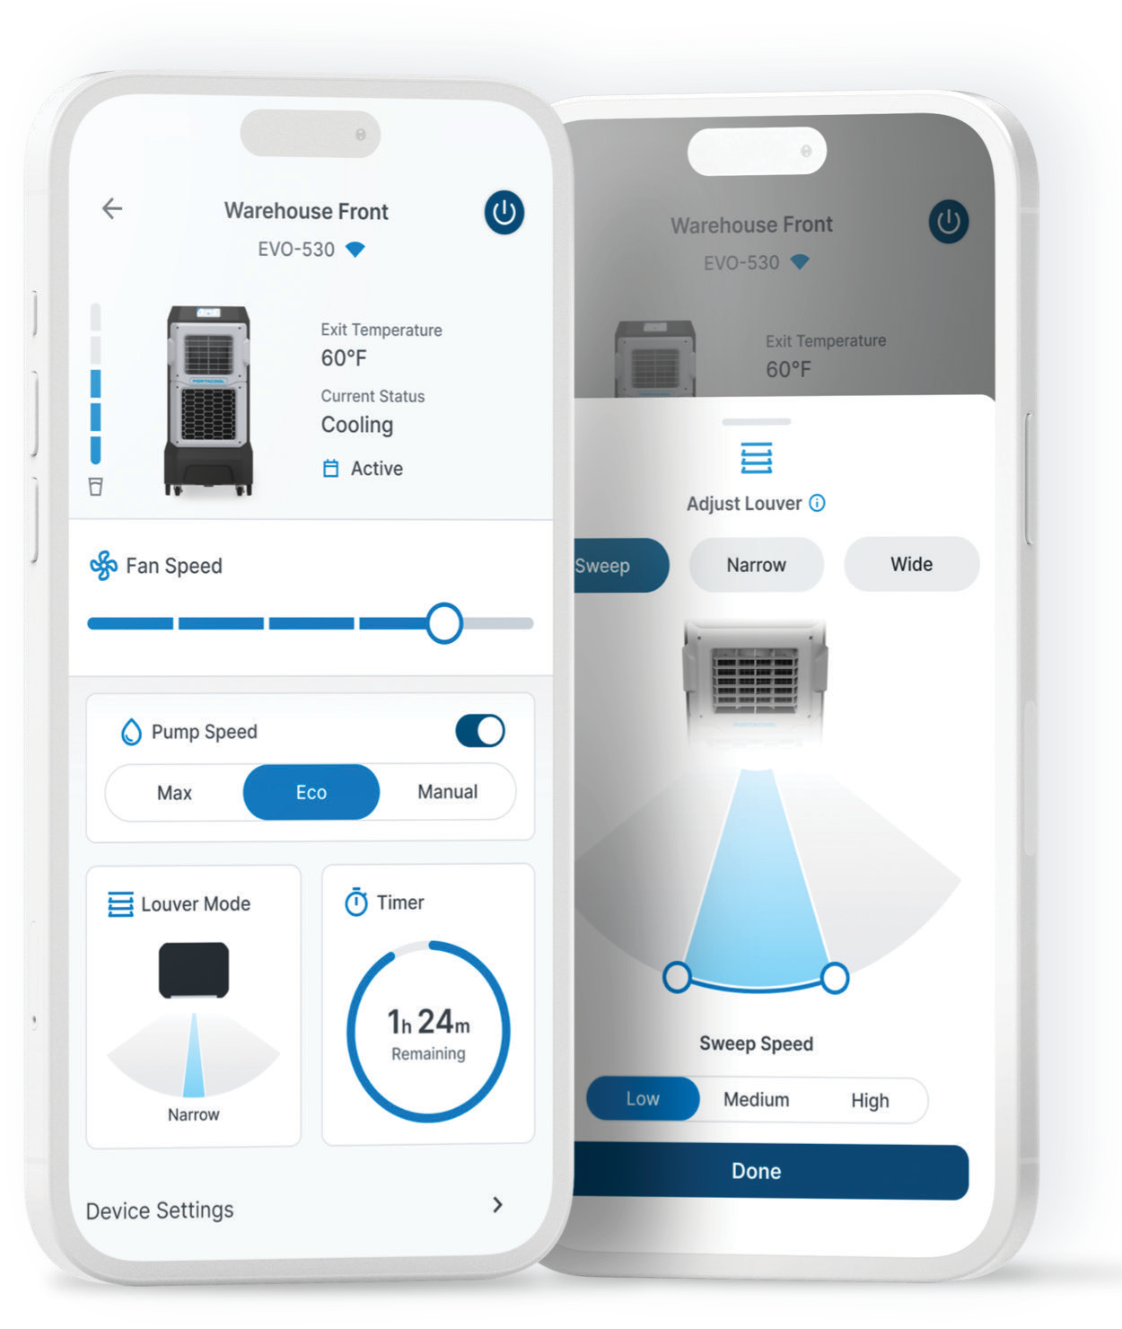
PRODUCT & POSITIONING
CoolSync™ TECHNOLOGY
CoolSync™ Technology brings smart connectivity to Portacool, offering seamless, remote control of your Portacool(s) from your mobile device. Designed for ultimate convenience and efficiency, CoolSync™ allows users to monitor and adjust their coolers from anywhere, ensuring optimal performance with minimal effort. CoolSync™ technology is unique to Portacool’s APEX™ Series coolers, and is a defined competitive advantage for Portacool.
Smart Cooling Made Simple
Experience the next level of cooling control with Wi-Fi-enabled Portacool models. Whether managing one unit or multiple across a workspace, CoolSync™ puts precision cooling in the palm of your hand.
Although Portacools can be operated from the control panel located on the APEX Series housing, the CoolSync™ App unlocks the full potential of each unit. With CoolSync™, users can control their Portacool(s) directly from their smartphone or mobile device, adjusting settings in real time to maintain the perfect cooling environment.
The CoolSync™ App
A user-friendly smartphone app provides instant access to every setting, allowing you to fine-tune your Portacool to match your needs. The CoolSync™ App is available in the Apple Store and Google Play Store, allowing you to stay cool, productive, and connected—wherever you are.
Complete Control at Your Fingertips
CoolSync™ allows users to remotely adjust fan speed, wind direction, and water control, ensuring precise cooling at all times. Scheduling features let you automate operation for maximum efficiency, while group syncing makes it easy to manage multiple Portacool units at once, all from a single mobile device.
With CoolSync™ Technology, you have the power to create the perfect environment anytime, anywhere. Whether at work or on the go, effortless cooling control is just a tap away and connected—wherever you are.

Slide 43
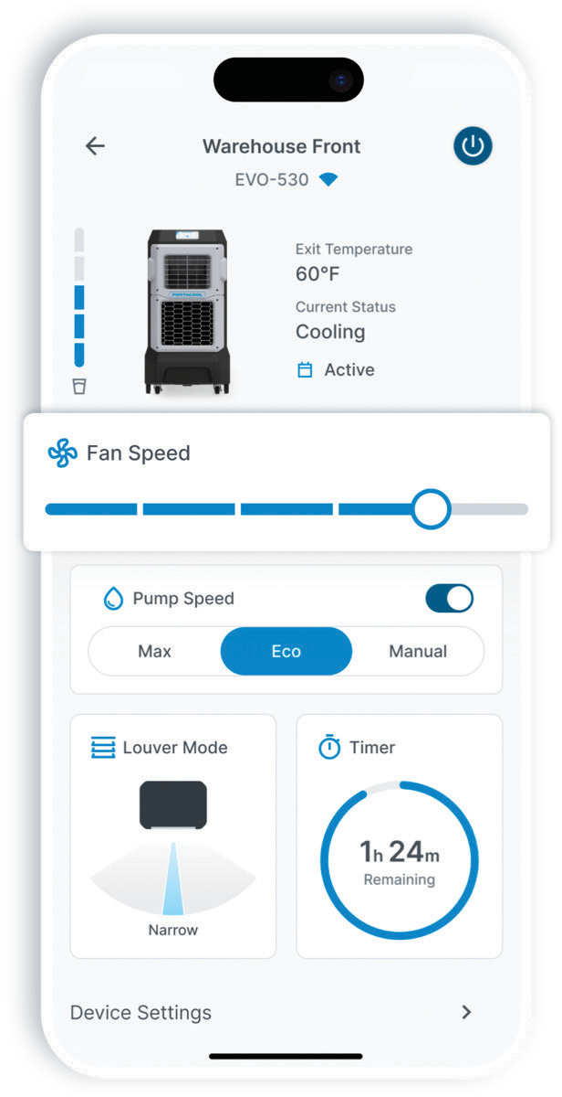
PRODUCT & POSITIONING
CoolSync™
Features & Benefits
CoolSync™ Technology enhances the efficiency, convenience, and control of Portacool’s APEX™ Series coolers, providing users with an intuitive, connected cooling experience. By integrating smart connectivity and remote access, CoolSync™ ensures seamless operation, precise adjustments, and maximum cooling performance with minimal effort.
This section outlines the key features and benefits of CoolSync™, demonstrating how it enhances usability, automation, and cooling efficiency to deliver a superior, hassle-free cooling solution.
Effortless Control from Anywhere
Forget about manual adjustments—CoolSync™ Technology lets you manage your cooler remotely from your smartphone or computer. Adjust fan speeds, power the unit on or off, and schedule runtimes from wherever you are, ensuring a consistently comfortable environment awaits you.
1
Enhanced Efficiency & Savings
CoolSync™ helps you optimize performance and monitor water levels, reducing energy costs and extending the life of your cooler. Enjoy a powerful, efficient cooling experience while saving on expenses.
2
Multi-Unit Management
Control multiple Portacool units simultaneously within the app. Whether managing a large space or multiple rooms, CoolSync™ allows centralized, synchronized control for all your cooling needs.
4
5
Real Time Monitoring
Stay informed about water levels with real-time updates and alerts, giving you the confidence that your cooler is performing at its best.
3
Convenience & Personalization
Tailor your environment to perfection with easy adjustments to fan speed and temperature. Create the ideal atmosphere for any setting, all from the convenience of your smartphone.
Timer & Auto Scheduling
Automate your cooling routine with scheduled start and stop times or set a timer for the exact cooling duration you need. This feature ensures optimal comfort while reducing unnecessary energy use.
6

Slide 44
PRODUCT & POSITIONING
CoolSync™
ICONOGRAPHY
Visual consistency is key to reinforcing the CoolSync™ Technology brand identity. Iconography plays an essential role in communicating the features and capabilities of CoolSync™ in a clear, intuitive, and visually engaging way.
This section provides guidelines on the approved icons used to represent CoolSync™ features, ensuring they are easily recognizable and effectively convey the smart connectivity, remote control, and automation benefits of the technology. Proper use of these icons enhances clarity, usability, and brand cohesion across all digital and print materials.
Control
Groups
Scheduling
Wind Direction
Monitor Status
Savings

Slide 45
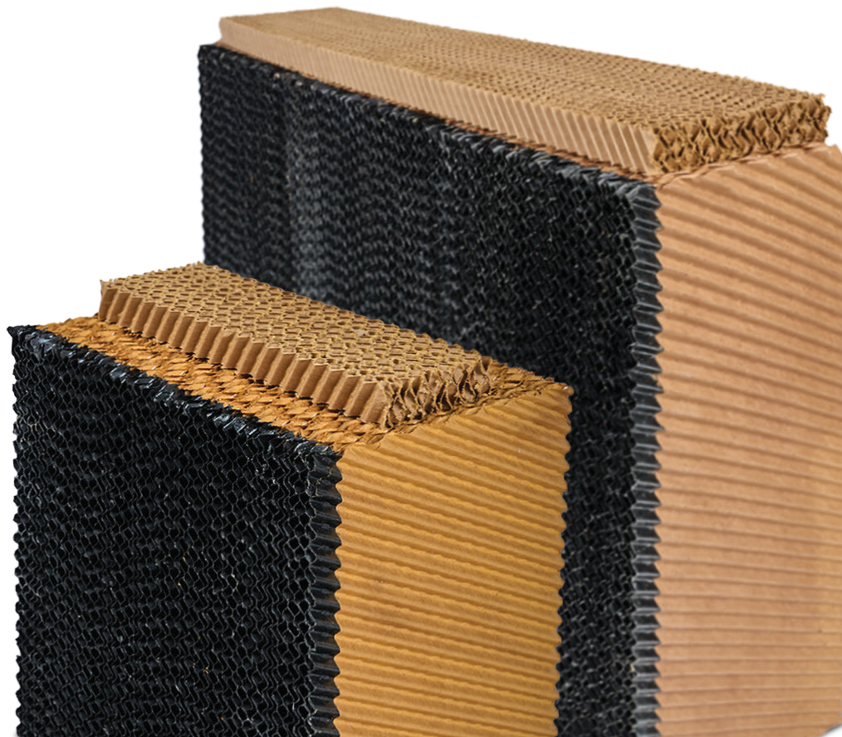
PRODUCT & POSITIONING
HYDROTEK™ EVAPORATIVE MEDIA
Portacool’s commitment to performance, efficiency, and durability is reflected in HydroTek™ Evaporative Media—a proprietary cooling media engineered for superior airflow, enhanced cooling power, and minimal maintenance. Designed to maximize evaporative efficiency, HydroTek™ sets a new standard for air quality, durability, and long- lasting performance in the Portacool APEX™ Series and beyond.
What’s Inside Matters
HydroTek™ Evaporative Media is built with premium materials and advanced design, ensuring unmatched cooling performance while maintaining cleaner air and lower maintenance requirements. By optimizing airflow and evaporation, HydroTek™ helps create a cooler, more comfortable environment with greater efficiency than standard evaporative media.
Advanced Design for Maximum Cooling
HydroTek™ media features a unique flute structure with 15-degree and 45-degree angles, increasing surface area for enhanced water absorption and accelerated evaporation. This advanced design improves airflow velocity, allowing cool air to circulate more effectively and maintain consistent, reliable cooling.
Better Media Means Better Air
Engineered as a self-cleaning evaporative media, HydroTek™ increases water flow along its leading edge, minimizing debris buildup and reducing the risk of clogging. This ensures optimal performance with little to no maintenance while naturally filtering out allergens and airborne particles, making it an excellent choice for those with respiratory sensitivities.
Superior Materials for Enhanced Performance
Crafted from high-grade, reinforced cellulose fibers infused with specialty resins, HydroTek™ is built for long-lasting durability. The innovative edge-coat technology prevents algae buildup and protects against UV damage, ensuring reliable performance even in the most demanding environments.
Future-Ready Cooling Solution
HydroTek™ is the new standard in evaporative media across all Portacool products, ensuring every unit delivers premium cooling results. As an integral component of Portacool’s advanced engineering, HydroTek™ enhances performance, efficiency, and longevity, setting Portacool apart from lower-quality alternatives.

Slide 46
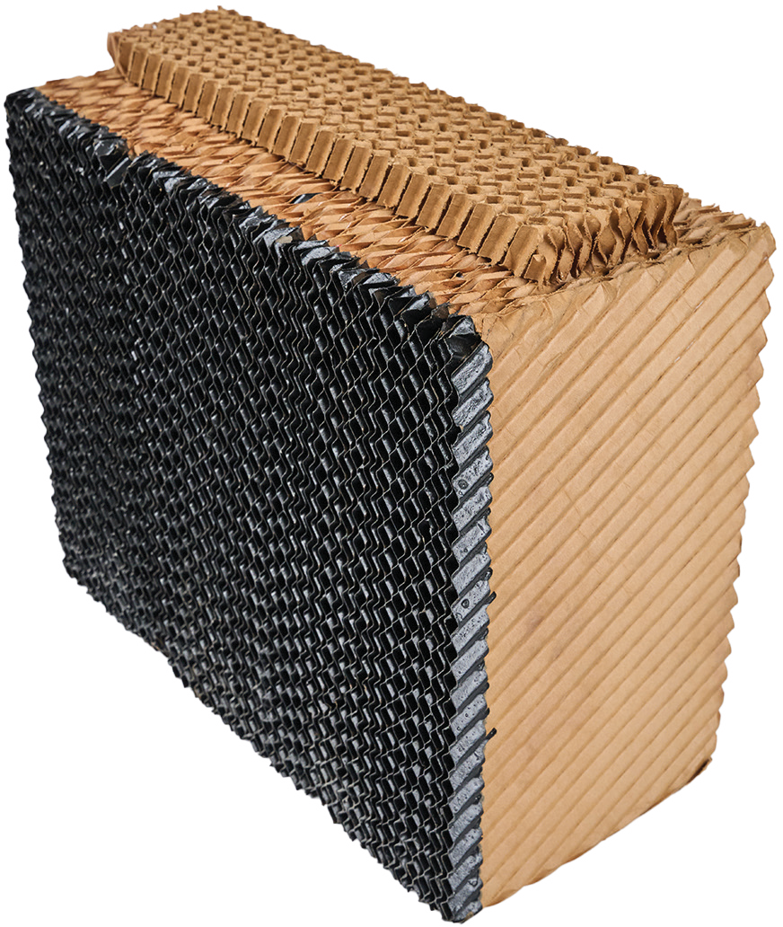
PRODUCT & POSITIONING
HYDROTEK™
Features & Benefits
HydroTek™ Evaporative Media is engineered for maximum cooling performance, durability, and efficiency, making it an essential component of Portacool’s industry-leading evaporative coolers. Designed with advanced materials and innovative technology, HydroTek™ enhances airflow, extends product longevity, and minimizes maintenance. This section outlines the key features and benefits that set HydroTek™ apart, ensuring superior cooling, cleaner air, and long-lasting reliability in even the most demanding environments.
Enhanced Airflow for Greater Cooling Power HydroTek’s innovative design improves airflow and velocity, increasing cooling efficiency. Maximize your evaporative cooler’s performance with HydroTek™ media for superior cooling results.
1
Durable Edge-Coat for Lasting Performance Experience enhanced durability with HydroTek™ evaporative media’s edge-coat technology, which repels algae and guards against UV damage for reliable, low-maintenance performance in tough environments.
4
5
Expanded Surface Area for Optimal Cooling HydroTek’s proprietary design increases media surface area, maximizing water evaporation and boosting cooling performance. Achieve unmatched efficiency and maintain optimal temperatures with HydroTek™.
Higher Quality for Lower Maintenance
HydroTek™ evaporative media’s design reduces debris accumulation, preventing clogging and ensuring optimal performance.
2
Superior Materials for Enhanced Cooling HydroTek™ media is built with reinforced cellulose fibers and specialty resins, delivering exceptional cooling and absorption. Experience optimal temperature reduction and improved efficiency.
3

Slide 47
APPLICATION & BRAND PLACEMENT
IN THIS SECTION
PRINT COLL ATER AL
DIGITAL COLL ATER AL
BR ANDED MERCHANDISE & APPAREL

Slide 48
APPLICATION & BR AND PL ACEMENT
APPLICATION & BRAND PLACEMENT
Consistent brand representation is essential for maintaining Portacool’s identity, credibility, and market presence across all platforms. Whether in packaging, print collateral, digital media, or branded merchandise, every application should reflect Portacool’s professional, high-quality image.
This section provides guidelines on how to correctly apply logos, colors, typography, and messaging across different marketing and promotional materials. By following these standards, Portacool ensures a cohesive brand experience that strengthens recognition, trust, and impact in every interaction.

Slide 49
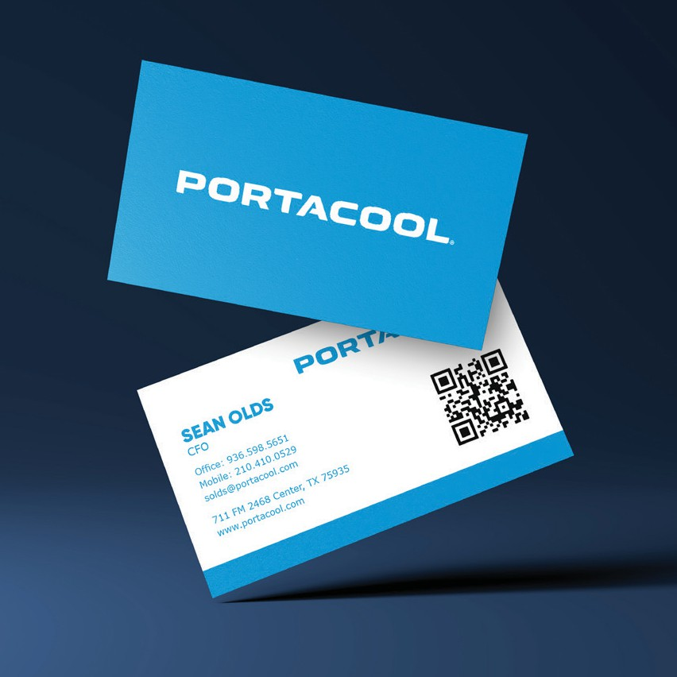
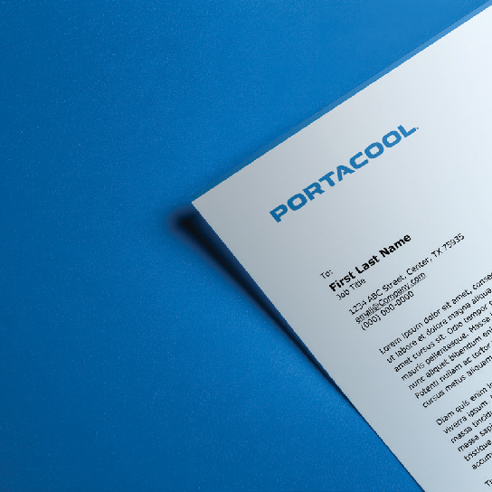
APPLICATION & BR AND PL ACEMENT
PRINT COLLATERAL
Portacool’s print materials play a vital role in reinforcing brand identity and professionalism. From stationery and business cards to marketing brochures and sales sheets, every piece of collateral should reflect Portacool’s commitment to quality and consistency.
DO
DO NOT
Follow approved color and logo placement guidelines to maintain brand consistency.
Use unapproved color schemes or alter logo placement.
Incorporate unapproved typefaces. If the primary fonts are unavailable, use only the approved alternative outlined in this guide.
Ensure consistent font usage, utilizing Normalidad Text & Normalidad Compact as the primary typefaces.
Maintain a clean, professional design that aligns with Portacool’s brand standards.
By adhering to these guidelines, all print materials will uphold the strength and clarity of the Portacool brand, ensuring a professional and cohesive presence across all communications.

Slide 50
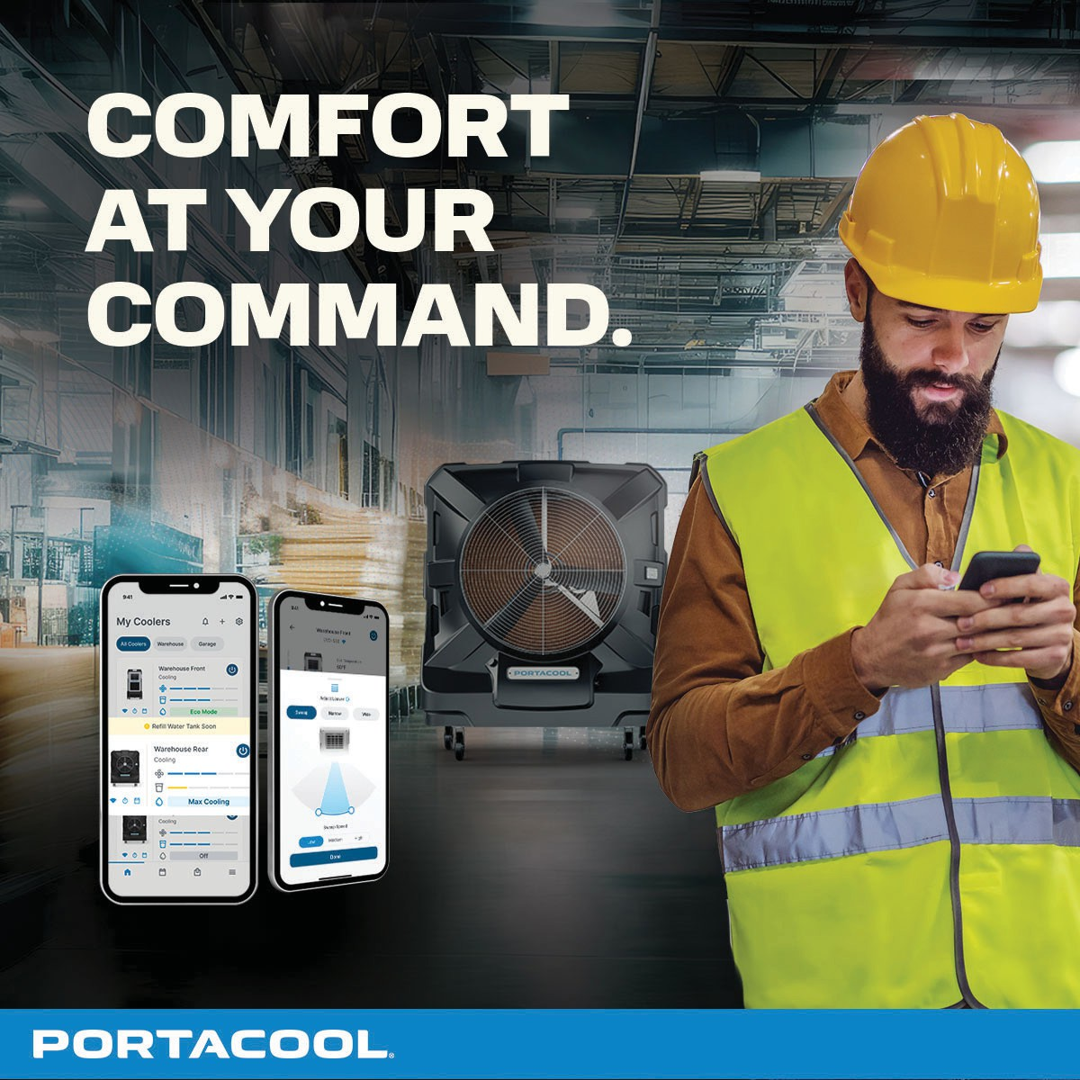
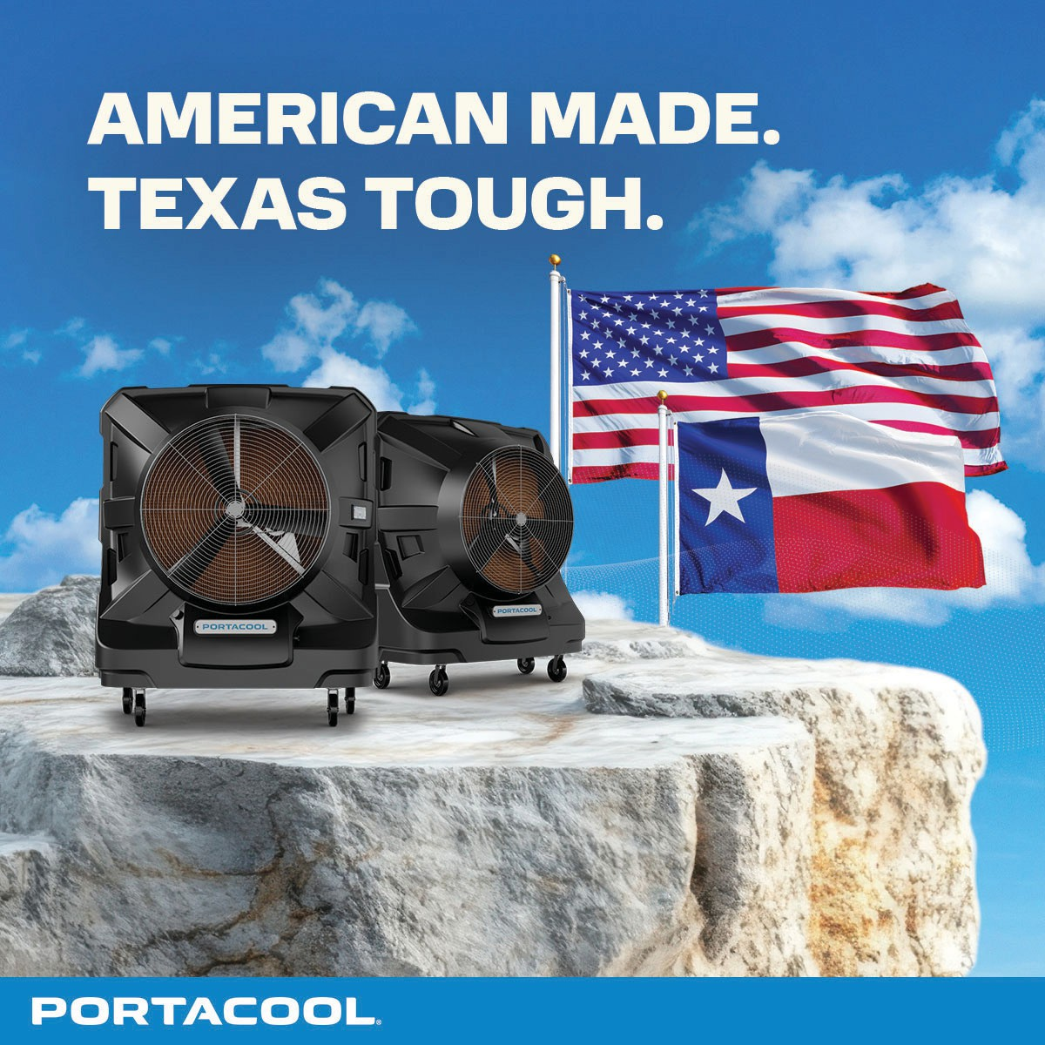
APPLICATION & BR AND PL ACEMENT
DIGITAL COLLATERAL
Portacool’s digital materials should be bold, clear, and visually impactful, ensuring brand consistency across web, social media, email, and digital advertising. Strong messaging and high-quality visuals reinforce Portacool’s authority and professionalism while enhancing engagement with the audience.
DO
DO NOT
Use bold headlines and concise captions to reinforce Portacool’s expertise and leadership.
Overlay text on busy or complex imagery that reduces readability.
Ensure high-quality, uncluttered images with strong contrast for maximum visibility and impact.
Use unapproved fonts or color schemes that do not align with Portacool’s brand guidelines.
By following these guidelines, all digital collateral will maintain a strong, cohesive brand presence, ensuring clarity, professionalism, and engagement across all platforms.

Slide 51
APPLICATION & BR AND PL ACEMENT
SOCIAL MEDIA GUIDELINES
Portacool’s social media presence is an essential part of brand awareness, customer engagement, and industry leadership. Every post, comment, and interaction should reflect Portacool’s commitment to quality, innovation, and customer service. These guidelines provide best practices for posting content, engaging with followers, and maintaining a professional and consistent brand voice.
How to Post
Best Practices for Social Media Engagement
n Be clear, concise, and engaging. Use bold headlines and strong visuals to capture attention quickly.
n Use brand-approved images, colors, and fonts to maintain consistency.
n Be responsive. Engage with followers regularly and answer questions in a timely manner.
n Incorporate short, benefit-driven captions that reinforce Portacool’s authority and product advantages.
n Follow Portacool’s brand voice and common phrases to speak on-brand.
n Maintain brand consistency. Keep messaging, tone, and visuals aligned with Portacool’s identity.
n Include relevant hashtags to expand reach and improve discoverability.
n Use a conversational, yet professional tone, keeping messaging informative and approachable.
n Engage with the audience by asking questions, encouraging feedback, and responding to comments.
n Monitor brand mentions. Stay aware of customer conversations and industry trends.
How to Respond to Comments
n Avoid controversial topics. Keep discussions focused on Portacool products, benefits, and industry insights.
Positive Comments
n Acknowledge and express appreciation. Thank customers for their support and enthusiasm.
n Encourage further engagement. Ask a follow-up question or invite them to share their experience.
n Encourage user-generated content. Share customer photos and testimonials to build credibility and community.
Example Response: “Thanks for your support! We’re glad you’re enjoying your Portacool. What’s your favorite feature so far?”
Negative Comments
n Remain professional and constructive. Do not engage in arguments or defensive responses.
n Acknowledge the concern and offer a solution. If necessary, move the conversation to a private channel.
n Respond promptly. A quick response demonstrates commitment to customer satisfaction.
Example Response: “We’re sorry to hear about your experience. Please send us a direct message so we can assist you further and find a solution.”
By following these guidelines, Portacool ensures a strong, professional, and engaging social media presence, fostering brand loyalty and meaningful customer relationships.

Slide 52
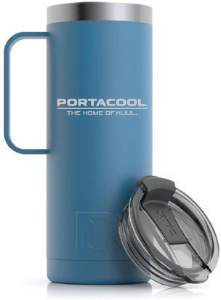
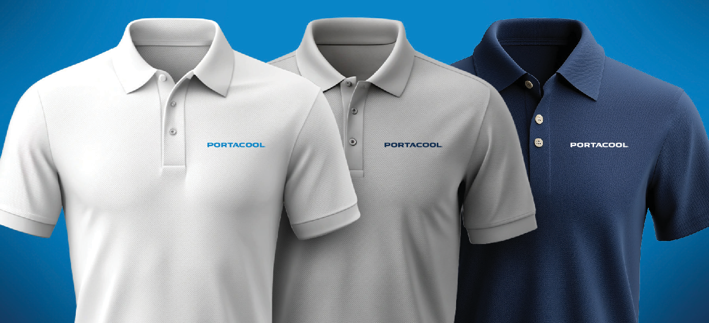
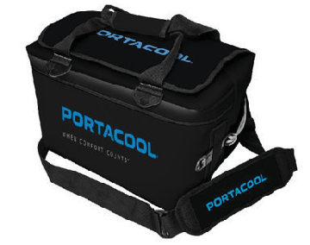
APPLICATION & BR AND PL ACEMENT
BRANDED MERCHANDISE & APPAREL
Portacool-branded merchandise and apparel serve as valuable tools for brand visibility, recognition, and loyalty. Whether used internally, as promotional giveaways, or for retail, all branded items must align with Portacool’s visual identity and quality standards to maintain a professional and consistent brand presence.
Guidelines for Branded Merchandise & Apparel
n Use official logo placements and brand colors to ensure consistency across all apparel and promotional products.
n Ensure high-quality print and embroidery applications that maintain the clarity, durability, and integrity of the Portacool brand.
By adhering to these guidelines, all Portacool merchandise will effectively represent the brand, reinforcing professionalism and trust while creating opportunities for increased brand recognition.

Slide 53
APPROVED ASSETS & RESOURCES
IN THIS SECTION
WHERE TO ACCESS BR AND ASSE T S
CONTAC T INFORMATION FOR BR ANDING SUPPORT

Slide 54
APPROVED ASSETS & RESOURCES
APPROVED ASSETS & RESOURCES
Maintaining brand consistency across all materials is essential for reinforcing Portacool’s identity and professionalism. To ensure all team members and partners have access to the correct assets, Portacool provides a centralized Media Kit containing approved logos, typefaces, graphics, and design elements.
Where to Access Brand Assets
n The Portacool Media Kit is available on SharePoint, containing official brand assets, including logos, typefaces, and graphics.
n Ensure that all brand materials are kept up to date and follow the latest brand guidelines to maintain consistency across all platforms.
Contact Information for Branding Support
For branding, design, or content inquiries, contact the Portacool Marketing Team at marketing@portacool.com.
By using the approved assets and resources, all brand materials will align with Portacool’s established identity, ensuring a cohesive and professional brand presence across all applications.
PORTACOOL BRAND GUIDE
54

Slide 55
BRAND MESSAGING
IN THIS SECTION
OUR ORIGIN STORY BR AND PERSONALIT Y & ARCHE T YPES
MISSION , VISION , AND VALUES BR AND VOICE
BR AND PROMISES COMMUNICATION ST YLE
BR AND PILL ARS TERMINOLOGY

Slide 56
BR AND MESSAGING
BRAND MESSAGING
Portacool’s brand messaging defines who we are, what we stand for, and how we communicate. A strong, consistent message ensures that every interaction—whether through marketing, customer service, or product positioning—reinforces Portacool’s leadership, innovation, and commitment to quality.
This section provides the foundational elements that shape Portacool’s brand identity, ensuring alignment across internal and external communications. From our origin story and core values to our brand voice and communication style, these guidelines help maintain a clear, compelling, and authentic brand presence.
The following pages will outline Portacool’s key messaging elements, ensuring that every communication touchpoint reflects our commitment to excellence, industry leadership, and customer-focused innovation.

Slide 57
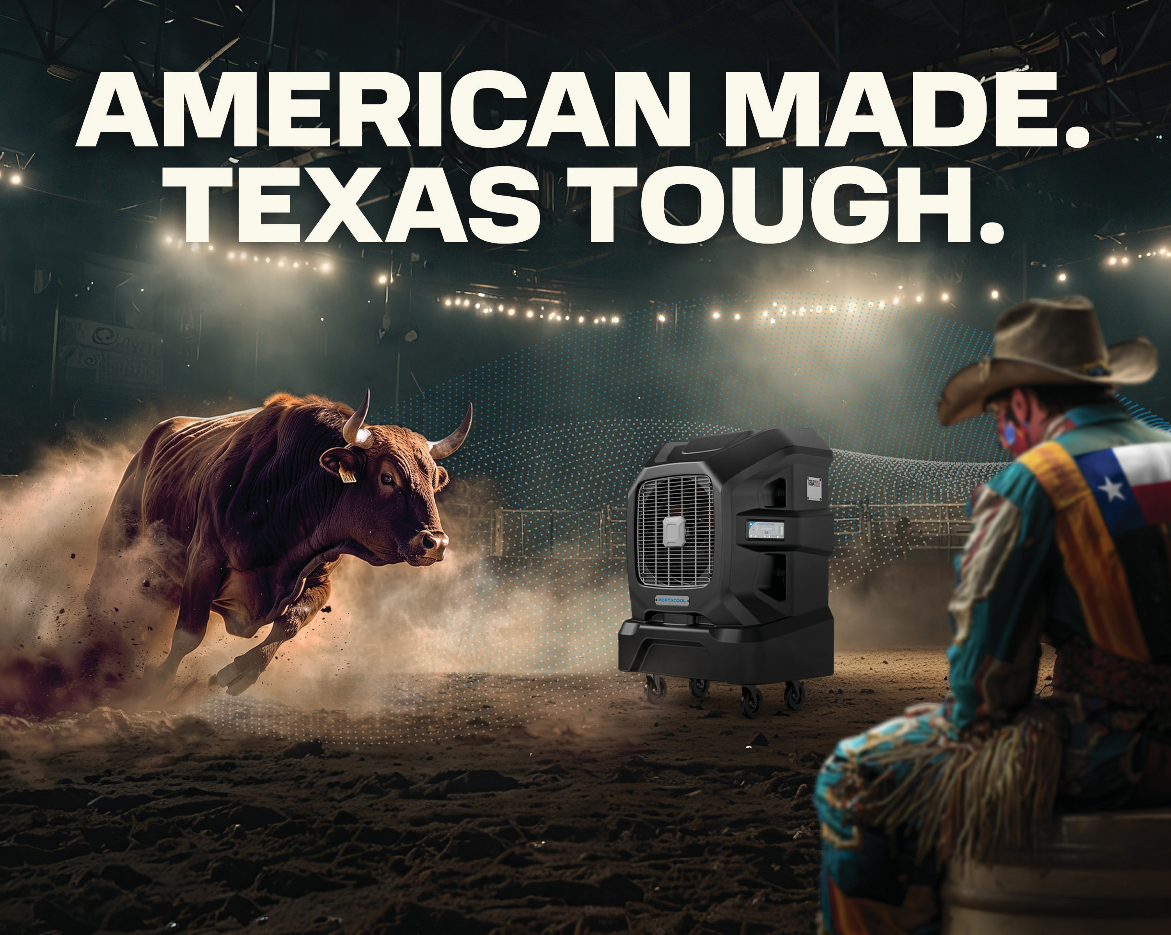

Slide 58


BR AND MESSAGING
OUR ORIGIN STORY
Portacool was founded on the belief that no environment is too hot, too open, or too challenging to be made more comfortable. From its humble beginnings in Center, Texas, in 1990, Portacool pioneered portable evaporative cooling, introducing a solution that redefined how businesses and industries approach heat relief.
American Made. Texas Tough.
Driven by durability, innovation, and performance, Portacool launched its first evaporative cooler from a small workshop. With a vision to provide powerful, economical cooling where traditional solutions failed, the company grew its reach - first, through East Texas, and then throughout the South. What started as a groundbreaking idea quickly set the industry standard, proving that Portacool coolers were built to handle the toughest conditions with unmatched reliability.
As demand surged, Portacool expanded its product lines, distribution, and global reach, growing from a Texas-based operation to a recognized leader in over 50 countries. Throughout this growth, one thing remained constant—an unwavering commitment to American-made craftsmanship and industry-leading performance.
Resilience Through Adversity
Portacool’s journey has not been without challenges. In 2023, a devastating fire destroyed its main manufacturing facility, putting its resolve to the test. Yet, true to its Texas-tough spirit, Portacool rebuilt, innovated, and came back stronger than ever. This pivotal moment fueled the launch of the Portacool APEX™ Series, alongside continued advancements in CoolSync™ smart technology and HydroTek™ Evaporative Media—solidifying Portacool’s position at the forefront of cooling innovation.
The Future of Cooling
Portacool remains dedicated to pushing the boundaries of evaporative cooling, ensuring that worksites, warehouses, and outdoor spaces stay productive, comfortable, and safe. As the de facto leader in portable evaporative cooling, Portacool continues to build on its legacy—offering solutions that are as transformative as they are strong.

Slide 59


Slide 60
BR AND MESSAGING
MISSION, VISION, AND VALUES
Portacool’s brand is built on a foundation of excellence, resilience, and innovation. These guiding principles define who we are, where we are going, and how we make a lasting impact. By aligning our mission, vision, and purpose, we reinforce our dedication to delivering superior cooling solutions that safeguard workers, empower businesses, and protect communities.
Our Mission
Superior Cooling Solutions Built for the Toughest Environments
We are Portacool, the leading portable evaporative cooling solutions manufacturer. For more than 30 years, we have safeguarded America’s workforce and way of life by providing superior cooling solutions that transform tough conditions into manageable environments for those working and living in extreme heat. Through American-made craftsmanship and design, best-in-class customer care, and one-of-a-kind innovations like CoolSync™, our products help people work smarter, safer, and perform at their best.
Our Vision
The Standard in Portable Evaporative Cooling
Portacool is more than an innovator—we are the industry standard in portable evaporative cooling. Our vision is to make Portacool synonymous with cooling solutions that empower America’s workforce, protect communities, and uphold a legacy of quality that transcends generations. As pioneers in the field, we continue to shape the future of evaporative cooling technology with a commitment to performance, reliability, and customer-first solutions.
Our Purpose
Safeguarding America’s Workforce
At Portacool, we believe that no one should have to choose between productivity and well-being. We are driven to make every workplace safer, more productive, and more comfortable by providing cooling solutions that protect workers from the dangers of extreme heat.
Our goal extends beyond cooling—it’s about helping businesses reduce risks, lower medical costs, and prevent productivity losses associated with hot working conditions. By delivering high-performance, cost-effective solutions, we support the health, safety, and success of our customers and the communities they serve.

Slide 61
BR AND MESSAGING
BRAND PROMISES & VALUES
Portacool’s brand promises define the core commitments we make to our customers, partners, and employees. These promises are driven by our Values, and serve as the foundation of trust, reliability, and innovation—ensuring that every Portacool product, service, and interaction reflects our unwavering dedication to our customers. By upholding these commitments, we reinforce Portacool’s leadership position, delivering solutions that safeguard workers, enhance productivity, and provide lasting value in the toughest environments.
OUR BRAND VALUES
Powerful Cooling by Design
OUR PROMISES
We Empower Your Performance
Safety & Liability Portacool is dedicated to protecting workers from the dangers of extreme heat, reducing the risk of heat-related injuries and illnesses. Our effective cooling solutions help safeguard employee well-being while also minimizing legal and insurance liabilities, creating a safer and more compliant work environment. | We are Dedicated to Your Well-Being. Portacool’s cooling solutions are designed with safety and comfort in mind, helping to protect your team from the dangers of extreme heat. By creating a cooler, more manageable work environment, we empower you to work confidently, efficiently, and without compromise.
Life & Comfort Enhancing Solutions Portacool products are designed to improve comfort and quality of life by creating cooler, more accommodating environments. Whether in the workplace or personal spaces, our cooling solutions help people stay focused, productive, and comfortable, without being hindered by extreme heat. | Your Moments Matter to Us. Portacool’s cooling solutions create comfortable, enjoyable environments for workspaces, events, and gatherings, ensuring that every moment—whether on the job or at play—is cool, refreshing, and memorable.
Total Cost of Ownership Portacool products are built for durability, efficiency, and long-term value, offering the lowest total cost of ownership in cooling solutions. With affordable operation, minimal maintenance, and reduced infrastructure requirements, Portacool delivers lasting comfort and performance with minimal ongoing expense. | We Deliver Long-term Value. With Portacool, you’re investing in durable, energy-efficient cooling solutions designed for maximum performance and minimal operational costs. Built to last and easy to use, Portacool coolers provide reliable, long-term value, ensuring cost-effective cooling in even the toughest environments
Productivity & Performance Portacool evaporative coolers combat the effects of extreme heat, helping to maintain productivity and efficiency in demanding environments. By creating a cooler, more comfortable workspace, Portacool enables workers to stay focused, perform at their best, and operate at peak efficiency—even in the hottest conditions. | We Help You Achieve More. Portacool evaporative coolers enhance productivity by keeping your team cool, focused, and comfortable, even in extreme heat. By creating a better working environment, we help you perform at your best and get the job done efficiently.
Sustainability & Social Responsibility Portacool is committed to eco-friendly cooling solutions that prioritize energy efficiency and environmental responsibility. Our evaporative cooling technology minimizes energy consumption and eliminates harmful refrigerants, providing sustainable, powerful cooling that helps protect both people and the planet. | We Care About the Communities We Serve. Portacool is committed to sustainable cooling solutions that prioritize energy efficiency and environmental responsibility. Our eco-friendly evaporative cooling technology reduces energy consumption and eliminates harmful refrigerants, providing effective, sustainable comfort for the communities we serve.

Slide 62
BR AND MESSAGING
BRAND PILLARS
Portacool’s brand pillars are the key differentiators that set us apart in the evaporative cooling industry. These core principles define who we are, what we stand for, and the unique value we provide to our customers. They serve as the foundation of our brand identity, shaping everything from product innovation and customer relationships to marketing and communication strategies.
By staying true to these pillars, Portacool ensures that every interaction, product, and service reflects our commitment to quality, performance, and customer success.
In marketing and content creation, these differentiators act as strategic guidelines, helping to craft consistent, compelling messaging that reinforces Portacool’s leadership in evaporative cooling. Whether developing advertising campaigns, website content, social media posts, or sales materials, each piece of communication should align with these pillars— ensuring that our messaging is clear, authoritative, and reflective of our brand strengths.

Slide 63
BR AND MESSAGING
BRAND PILLAR #1: THE ORIGINAL
First-to-Market with Over 30 Years of Expertise
As the original portable evaporative cooler on the market, Portacool has led the industry from day one, leveraging over three decades of expertise to deliver trusted, high-performance cooling solutions. Since pioneering the first portable evaporative cooler, we have remained at the forefront of innovation, continuously refining our products to meet the evolving needs of industries worldwide.
Portacool’s deep-rooted experience is evident in every product we make—designed for durability, efficiency, and reliability. With our history as the foundation, we continue to set the standard in portable cooling, proving that experience matters when it comes to performance.
Simply put, we are the original and the standard by which all other coolers are judged.
Why This Matters
We Demonstrate This Value by
n Customers value a brand with a proven track record and established credibility, especially for equipment essential to productivity and safety.
n Showcasing Portacool’s latest milestone achievements, such as the Portacool APEX™ Series, CoolSync™, and HydroTek™, reinforcing our role as pioneers and continuous innovators in the cooling industry.
n As the first-to-market leader, Portacool’s longstanding presence provides assurance, positioning our brand as a trusted and knowledgeable choice.
n Sharing customer stories and case studies that highlight the durability and performance of Portacool products in the most challenging environments.
n Decades of experience allow Portacool to anticipate market needs and develop innovative solutions tailored to extreme environments.
n Emphasizing our presence in all 50 U.S. states, reinforcing the widespread trust and credibility Portacool has earned.
n Our history reassures customers that they are choosing a brand with enduring expertise, stability, and an unwavering commitment to quality.
n Leveraging endorsements and testimonials from industry professionals who have firsthand experience with the reliability and quality of Portacool solutions.
Portacool’s legacy is built on proven performance, lasting innovation, and customer trust—ensuring that we remain the original and the best in portable evaporative cooling.

Slide 64
BR AND MESSAGING
BRAND PILLAR #2: THE STANDARD
Best-in-Class Performance and Reliability
Portacool has set the industry standard in evaporative cooling by delivering products that are powerful, durable, and built to last. With Portacool Protect™, our industry-leading warranty program, we stand behind every product, providing customers with unmatched reliability and peace of mind.
Portacool Protect™ offers comprehensive warranty coverage, including up to five years on electrical components and a lifetime warranty on housing, demonstrating our confidence in the long-lasting quality and resilience of every Portacool cooler. Beyond warranties, we offer dedicated technical support and live customer service, ensuring a worry-free ownership experience and reinforcing that Portacool is with customers for the long haul.
Why This Matters
We Demonstrate This Value by
n Customers need cooling solutions they can depend on, especially in high-demand environments where durability and performance are critical.
n Prominently featuring the Portacool Protect™ program in marketing materials to highlight our commitment to product durability and customer support.
n Best-in-class warranties eliminate concerns about maintenance and replacement, giving customers confidence in the long-term value of their investment.
n Providing an easy-to-use product registration process, ensuring a personalized service experience with proactive maintenance reminders.
n In a competitive market, leading warranties provide a strong assurance that Portacool is committed to quality, reinforcing customer trust in our brand.
n Offering web-accessible, live customer support to help troubleshoot issues, answer questions, and provide expert guidance.
n Ongoing customer support through Portacool Protect™ establishes us as a true partner, offering dependable service and support throughout the product’s lifetime.
n Sharing customer testimonials and success stories that showcase the lasting value and reliability of Portacool products and support.
n Clearly displaying warranty information on product packaging, landing pages, and manuals to reinforce our industry-leading commitment to quality and service.
Portacool doesn’t just manufacture best-in-class cooling solutions—we set the standard with unmatched reliability, long- term customer support, and industry-leading protection.

Slide 65
BR AND MESSAGING
BRAND PILLAR #3: FIVE-STAR CUSTOMER CARE
World-Class Care with a Hometown Touch
As a global leader in portable evaporative cooling, Portacool combines the reach and resources of an enterprise brand with the personalized service of a hometown company. Our commitment to exceptional customer care extends far beyond the sale—we build lasting relationships and ensure that every customer feels supported and valued.
With a nationwide distributor network across all 50 U.S. states, Portacool provides a localized, personalized experience wherever our products are used. Our US-based manufacturing, rapid shipping capabilities, and accessible resources— including instructional videos, buyer guides, owner manuals, and live technical support—ensure that customers have the tools and assistance they need to keep their Portacool running at peak performance.
Why This Matters
We Demonstrate This Value by
n Customers need reliable, ongoing support, especially in high-demand environments where equipment performance is critical.
n Providing easy-to-access customer resources, including a literature center, buyer guides, instructional videos, FAQ pages, and comprehensive product manuals.
n Accessible and responsive customer service fosters trust and loyalty, reinforcing Portacool as a brand that genuinely cares about its users.
n Offering live, responsive customer support from a dedicated team, ensuring customers receive expert guidance and timely assistance.
n Our blend of global reach and localized care creates a community of support, ensuring customers always have a trusted partner when challenges arise.
n Showcasing our robust distribution network and in-stock inventory for fast, dependable shipping and support nationwide.
n Fast, reliable logistics and ready-to-ship inventory reduce downtime, providing a significant advantage in delivering timely solutions nationwide.
n Communicating our commitment to customer care across all buying touchpoints—from the initial purchase to post-sale support—so every customer feels valued and supported.
n Sharing customer success stories and testimonials that highlight Portacool’s dedication to helping customers succeed across diverse applications and industries.
At Portacool, we don’t just sell cooling solutions—we stand by our customers every step of the way, delivering five-star service that keeps them cool, confident, and supported.

Slide 66
BR AND MESSAGING
BRAND PILLAR #4: PROUDLY MADE IN THE USA
Advanced Design and Unmatched Durability
Portacool proudly designs and manufactures its products in Center, Texas, USA, ensuring that every cooler embodies the pinnacle of American engineering and craftsmanship. Our commitment to advanced design and quality materials means that each unit is meticulously crafted to deliver maximum cooling efficiency, durability, and long-term performance.
Manufacturing in the USA allows Portacool to maintain strict control over every aspect of design and production, guaranteeing the exceptional quality and reliability that our customers expect. More than just a point of pride, our American-made craftsmanship supports local jobs and communities, reinforcing the strength, resilience, and dependability that defines both our products and our brand.
Why This Matters
We Demonstrate This Value by
n “Made in the USA” builds trust. Customers associate American manufacturing with reliability, craftsmanship, and durability, reinforcing Portacool’s reputation for quality products built to last.
n Prominently featuring “Made in the USA” on product packaging, websites, and marketing materials to communicate our commitment to American manufacturing.
n Showcasing American craftsmanship through stories, videos, and images of our skilled workforce and manufacturing facilities, connecting customers with the people behind the products.
n American-made means advanced design excellence. Portacool leverages cutting-edge technology and engineering expertise to create industry-leading cooling solutions with superior performance.
n Highlighting engineering advancements in our coolers, such as optimized airflow systems, energy-efficient components, and proprietary technologies that enhance performance.
n Domestic manufacturing ensures quality control. Overseeing every step of production allows us to maintain strict adherence to quality standards and quickly implement design innovations.
n Sharing the stories of hardworking American employees who design, build, and support our products, reinforcing the authenticity of Portacool’s American-made promise.
n Supporting local manufacturing resonates with customers. Shorter supply chains, investment in American workers, and sustainable production practices make U.S.-made products a preferred choice.
n Educating customers on the benefits of U.S.-based manufacturing, including stringent quality control measures and certifications, ensuring unmatched reliability and performance.
At Portacool, American-made isn’t just a label—it’s a promise of quality, innovation, and durability that customers can trust in the toughest environments.

Slide 67
BR AND MESSAGING
BRAND PILLAR #5: INDUSTRY-LEADING INNOVATION
Advancing the Science of Evaporative Cooling
Portacool is at the forefront of innovation in portable cooling solutions, continuously pushing boundaries to develop advanced technologies that enhance comfort, control, and efficiency. Our coolers are engineered to outperform the competition by leveraging the science of evaporative cooling, delivering maximum cooling efficiency with minimal environmental impact.
At the heart of this innovation is CoolSync™ Technology—a groundbreaking advancement that provides unparalleled control and customization. With Wi-Fi connectivity and an intuitive mobile app, CoolSync™ Technology allows users to sync their Portacool to a smartphone, enabling them to adjust fan speeds, monitor water levels, schedule operation, and control multiple units simultaneously from anywhere. This level of personalized control enhances user convenience while optimizing cooling efficiency, making Portacool the ultimate solution for smart, effective, and cost-efficient cooling.
Why This Matters
We Demonstrate This Value by
n Customers seek modern, convenient solutions that integrate seamlessly into their workspaces and lifestyles.
n Educating customers on the science of evaporative cooling, highlighting how Portacool’s unique designs and CoolSync™ Technology deliver measurable performance improvements.
n Innovative technology like CoolSync™ sets Portacool apart from competitors, reinforcing our status as an industry leader.
n Showcasing CoolSync™ features through demos, videos, and interactive content that illustrate its functionality and benefits.
n Advanced control features enhance performance, reduce energy costs, and improve the user experience, offering customers greater value.
n Sharing customer success stories and testimonials from users who have experienced enhanced comfort, efficiency, and convenience with CoolSync™ Technology.
n Providing smart technology aligns with the growing demand for IoT (Internet of Things) devices, appealing to tech-savvy consumers and businesses.
n Communicating cost-saving benefits, demonstrating how CoolSync™ reduces energy consumption and extends unit lifespan, making it a smart investment for environmentally conscious and budget-aware customers.
n Continuous innovation keeps Portacool ahead of the competition, ensuring long-term customer satisfaction and brand loyalty.
Portacool isn’t just keeping up with industry advancements—we’re leading the way, redefining portable evaporative cooling with cutting-edge innovations that enhance performance, efficiency, and user experience.

Slide 68
BR AND MESSAGING
BRAND PILLAR #6: PERFORMANCE THAT OUTLASTS
Superior Performance Powered by What’s Inside
At Portacool, we believe that what’s inside matters, and our HydroTek™ Evaporative Media sets a new industry standard for durability, cooling efficiency, and air quality. Engineered for maximum airflow and long-lasting performance, HydroTek™ is the core of every Portacool cooler, ensuring consistent temperature reduction and minimal maintenance—even in the most demanding environments.
Crafted from premium, reinforced cellulose fibers and treated with specialty resins, HydroTek™ media delivers superior cooling power, while its self-cleaning design reduces clogging, prolongs product life, and lowers maintenance costs. This advanced evaporative media differentiates Portacool, providing exceptional cooling performance that customers can rely on—year after year.
Why This Matters
We Demonstrate This Value by
n Customers who want the best cooling performance understand that evaporative media quality is crucial when selecting a cooler—this is a long-term investment, and they expect superior materials.
n Prominently featuring HydroTek™ as a Portacool differentiator in marketing materials, ensuring customers recognize it as a key feature that sets us apart.
n Educating customers on the advanced materials and engineering behind HydroTek™ through blogs, white papers, and technical content.
n Maintenance costs can add up. HydroTek™’s durability and efficiency mean fewer replacements, lower energy consumption, and long-term savings, making it a cost- effective choice.
n Showcasing customer testimonials and case studies that highlight HydroTek™’s long-lasting reliability and cooling efficiency in demanding environments.
n Cleaner air creates a healthier workspace. HydroTek™’s air-filtering properties provide additional value for businesses that prioritize worker well-being.
n Partnering with influencers and industry experts to emphasize HydroTek™’s air quality benefits, particularly for workplaces where respiratory health is a priority.
n A self-cleaning design extends product life. By reducing clogging and buildup, HydroTek™ requires less frequent maintenance, providing hassle-free performance.
HydroTek™ Evaporative Media is more than just a component—it’s a commitment to lasting performance, cleaner air, and superior cooling efficiency. When it comes to durability, reliability, and innovation, Portacool outperforms the rest.

Slide 69


BR AND MESSAGING
BRAND PERSONALITY & ARCHETYPES
Our Brand Archetype: The Ruler with a Touch of Magician
Portacool’s brand voice is more than just words—it’s the embodiment of our confidence, resilience, and expertise. It reflects who we are, what we stand for, and how we connect with our customers. Our voice is authoritative yet approachable, ensuring that every interaction reinforces trust, leadership, and innovation.
At the core of Portacool’s brand identity is The Ruler archetype—strong, dependable, and in control. Like our products, our messaging commands authority and instills confidence, providing customers with reliable solutions that perform in the toughest conditions. Complementing this strength is The Magician, bringing an element of transformation and innovation. This influence allows Portacool to communicate not just power and durability, but also aspiration, ingenuity, and the ability to redefine what’s possible in evaporative cooling.
Portacool’s voice is:
n Clear and bold, delivering precise, no-nonsense messaging that reflects the dependability of our products.
n Minimalistic and impactful, ensuring every word reinforces our expertise and leadership.
n Confident and empowering, positioning Portacool as a trusted partner that helps users take control of their environment.
More than just a way of speaking, our brand voice is a promise—a commitment to durability, innovation, and mastery over extreme conditions. Whether through product messaging, customer service, or marketing materials, Portacool doesn’t just provide cooling solutions—we provide control, comfort, and confidence in even the most challenging environments.
THE RULER
THE MAGICIAN

Slide 70
BR AND MESSAGING
ARCHETYPE & BRAND VOICE
Portacool’s brand personality is shaped by two complementary archetypes—The Ruler and The Magician. Together, they define the brand’s tone, communication style, and overall presence, ensuring that every message reflects confidence, innovation, and reliability.
The Ruler establishes Portacool as the authority in evaporative cooling, embodying strength, control, and dependability. Meanwhile, the Magician brings an element of innovation and transformation, elevating Portacool’s solutions beyond simple cooling to an experience of precision-engineered comfort.
This blend allows Portacool’s brand voice to be assertive yet refined, powerful yet approachable, making it easy for customers to trust that Portacool coolers won’t just withstand the elements—they’ll dominate them.
Primary Archetype: The Ruler
Portacool embodies the authoritative and commanding presence of The Ruler, reinforcing its position as the category leader in evaporative cooling. In the rugged, demanding environments where cooling solutions are essential, Portacool represents:
n Control – Providing mastery over extreme conditions with reliable cooling solutions.
n Strength – Built with American craftsmanship, Portacool products are tough, durable, and resilient.
n Dependability – Customers can trust Portacool to perform when it matters most.
As a Ruler brand, Portacool’s tone is assertive, bold, and confident without arrogance. The brand communicates with directness and authority, using a clear, no-nonsense approach that reinforces trust and leadership. This tone reflects Texas confidence and grounded American values, ensuring that every interaction with Portacool carries a sense of stability and power.

Slide 71
BR AND MESSAGING
ARCHETYPE & BRAND VOICE (CONTINUED)
Secondary Archetype: The Magician
While The Ruler defines Portacool’s strength, The Magician archetype adds an element of innovation, precision, and transformation. This aspect of the brand elevates Portacool from simply being a cooling provider to a pioneer in engineered comfort, making the impossible effortless. The Magician influence is reflected in:
n Proprietary technology – Innovations like CoolSync™ and HydroTek™ redefine expectations for portable cooling.
n Seamless, intuitive solutions – Portacool coolers don’t just cool, they transform environments into controlled, comfortable spaces.
n Precision-engineered performance – The brand presents its products as more than machines; it presents them as feats of innovation and problem solving.
This influence brings an elevated sophistication to Portacool’s rugged reliability. While the Ruler conveys power, the Magician adds a refined, intelligent edge—allowing the brand to speak to customers who value mastery, high standards, and innovation.
How to Apply the Brand Voice
Portacool’s brand voice blends The Ruler’s bold confidence with The Magician’s refined sophistication, ensuring that every message is:
n Straightforward and impactful, with authority and precision.
n Clear and accessible, avoiding unnecessary technical jargon while reinforcing expertise and reliability.
n Commanding yet refined, promising power with innovation—mirroring the high-performance engineering behind every Portacool product.
This balance allows Portacool to communicate as a trusted leader, ensuring customers feel empowered, in control, and confident that they’ve chosen the best in portable evaporative cooling.

Slide 72
BR AND MESSAGING
A DEEPER EXPLANATION OF THE RULER ARCHETYPE
Portacool’s Ruler archetype exudes authority, confidence, and unyielding power, ensuring dominance in any environment. As the leader in portable evaporative cooling, Portacool commands respect through its reliability, strength, and consistent performance.
This archetype defines Portacool as a bold, resilient solution, built to withstand harsh environments and set the industry standard for both innovation and rugged durability. The Ruler is confident and authoritative, yet never arrogant—a powerful force that leads by example, not by shouting.
Key Attributes of The Ruler
Tone and Language
1
Authority and Confidence
Portacool is assertive in its leadership role, ensuring total control over the environments it cools. Customers trust Portacool to deliver unmatched performance, knowing they are investing in a category-defining brand.
The language of The Ruler is commanding yet grounded. Portacool’s messaging is direct, bold, and authoritative, avoiding excessive descriptions or unnecessary technicalities.
n Confident yet approachable – Messages should be clear, simple, and powerful, conveying expertise without arrogance.
2
Strength and Durability
The Ruler’s strength is embodied in Portacool’s industrial-grade build and premium performance. Every product is designed to withstand the toughest conditions, reinforcing Portacool’s reputation for durability and resilience.
n Straightforward and impactful – Every statement should reinforce trust and steadfast capability.
n Bold and decisive – Portacool owns its leadership position and speaks with the confidence of an industry-defining brand.
3
Dependability
The Ruler’s power lies in reliability. Portacool is built on a foundation of long- lasting, high-performance products, ensuring that customers can trust their investment time and time again.
This tone ensures that every Portacool communication aligns with the strength, reliability, and leadership of The Ruler archetype—delivering a message of power, trust, and unwavering performance.
4
American Pride and Resilience
Portacool reflects the boldness, endurance, and pride of American craftsmanship. Built in Texas and designed to lead, our products embody the rugged, determined spirit that defines American innovation.

Slide 73
BR AND MESSAGING
MESSAGING EXAMPLES: THE RULER ARCHETYPE
Portacool’s Ruler archetype is reflected in messaging that conveys authority, leadership, and unmatched expertise. Every statement reinforces Portacool’s commanding presence in the industry, ensuring that customers recognize it as the benchmark for portable evaporative cooling. Here are a few ways you can speak like The Ruler in Portacool communications.
The OG of Evaporative Cooling Technology
As the original innovators in portable evaporative cooling, Portacool has set the standard and set the pace since 1990. First-to-market, best-in-class, and built on decades of expertise, Portacool continues to bring proven durability and innovation to every product. When you choose Portacool, you’re choosing the OG of cooling technology—where innovation meets legacy, and excellence is built in.
Intended Result: Reinforces Portacool’s pioneering role in the industry, positioning it as the original leader that continues to set the pace and stay ahead of competitors.
No Copy, No Comparison
Portacool isn’t just an option; it’s the benchmark. For those who settle for nothing but the best, there’s no copy and no comparison. When you need unmatched cooling performance, reliability, and innovation, there’s only one—there’s only Portacool.
Intended Result: Establishes Portacool as the gold standard, appealing to high-demand users who prioritize safety, compliance, and peak performance.
American-Made, Texas Tough
Born in Texas, trusted nationwide. Portacool is built for the toughest jobs, withstanding every challenge with American- made durability and grit. From our manufacturing facility in Center, Texas, we craft each Portacool with a commitment to quality that’s as strong as the Lone Star State. When the heat is on, trust the brand that’s Texas tough.
Intended Result: Reinforces Portacool’s heritage of American craftsmanship, appealing to customers who value strength, resilience, and U.S.-made quality

Slide 74
BR AND MESSAGING
MESSAGING EXAMPLES: THE RULER ARCHETYPE (CONTINUED)
Five-Star Support, Every Step of the Way
Portacool is committed to supporting you long after the sale. With dedicated customer service, technical support, and industry-best warranties, we’re your partner for the journey.
Intended Result: Positions Portacool as a customer-first brand that provides ongoing support, reinforcing reliability and long-term value.
Pioneers Who Set the Pace
Portacool stands at the forefront with continual advancements in our CoolSync™ Technology. We’re redefining smart, efficient, and high-performance cooling solutions across America’s industries.
Intended Result: Establishes Portacool as the leader in smart, connected cooling solutions, appealing to customers looking for innovative, IoT-enabled performance.
Outperform, Outlast, and Outclass the Competition
Equipped with HydroTek™ Evaporative Media, Portacool is engineered to excel where others fall short. Choose the brand that not only meets industry standards but sets them—Portacool: where lasting quality and powerful cooling come together to outclass the competition, every time.
Intended Result: Emphasizes Portacool’s superior durability and performance, ensuring customers trust it as the strongest, most reliable cooling solution on the market.
Each of these examples reflects The Ruler archetype’s commanding presence, ensuring that Portacool’s messaging is always bold, authoritative, and undeniably superior in the world of evaporative cooling.

Slide 75
BR AND MESSAGING
A DEEPER EXPLANATION OF THE MAGICIAN ARCHETYPE
While Portacool’s primary identity is rooted in the commanding presence of The Ruler, its secondary archetype, The Magician, introduces an element of sophisticated transformation and seamless innovation. This archetype elevates Portacool beyond just a cooling solution, creating an experience that feels effortless yet powerful—as if extreme heat is magically turned into comfort.
The Magician archetype speaks to Portacool’s precision engineering, advanced technology, and intuitive design, making even the most challenging environments cool and comfortable. It conveys that Portacool isn’t just functional—it’s exceptional, harnessing ingenuity to create intelligent, problem-solving cooling solutions.
This archetype also brings an aspirational quality to the brand, inviting customers to experience the transformative power of Portacool—not just as a cooling device, but as a tool that enhances their environment, productivity, and overall well-being.
Key Attributes
Tone and Language
1
Innovation and Transformation
The Magician shines through Portacool’s cutting-edge technology, which delivers an almost magical transformation of extreme heat into comfort. Smart engineering, like CoolSync™ Technology and HydroTek™ Evaporative Media, allows Portacool to redefine cooling performance in ways that feel effortless and intuitive.
The language of The Magician is refined, precise, and subtly awe-inspiring. While Portacool’s Ruler voice is bold and commanding, The Magician brings an element of quiet mastery, reinforcing that Portacool’s effectiveness is not just about engineering— it’s about innovation as an art form.
n Confident, yet subtly awe-inspiring – Messaging conveys expertise and reliability while leaving room for intrigue and admiration.
2
Precision and Subtlety
Portacool’s design is intelligent, seamless, and effortless in execution. The Magician adds a layer of sophistication, positioning Portacool as the quiet, powerful solution that integrates effortlessly into demanding environments.
n Refined and polished – Words are clear and impactful, avoiding excessive technical jargon while reinforcing Portacool’s precision.
n Inspiring and aspirational – Messaging should invite customers to experience Portacool as more than just a product—it’s a solution that transforms.
3
Inspiring Wonder and Possibility
The Magician archetype is about possibility and transformation. Portacool doesn’t just cool spaces—it redefines them, presenting cooling as an experience that enhances well-being, productivity, and comfort, even in the harshest conditions.
By blending the commanding authority of The Ruler with the sophisticated ingenuity of The Magician, Portacool not only leads the industry—it redefines what’s possible in portable evaporative cooling.
By blending the commanding authority of The Ruler with the sophisticated ingenuity of The Magician, Portacool not only leads the industry—it redefines what’s possible in portable evaporative cooling.

Slide 76
BR AND MESSAGING
MESSAGING EXAMPLES: THE MAGICIAN ARCHETYPE
Transformative Comfort for the Toughest Spaces
Portacool’s APEX™ Series doesn’t just cool—it transforms with ease. Powered by the advanced science of evaporative cooling, Portacool turns the impossible into the achievable—converting extreme heat into a refreshing breeze.
Intended Result: Encourages users to see Portacool as an extraordinary solution, capable of performing beyond ordinary expectations—as if cooling is effortless, almost magical.
Intuitive Precision, Whisper-Quiet Performance
Portacool lowers the temperature by up to 30°F with intuitive control and seamless performance that adapts effortlessly to your needs. Experience the quiet strength of precision-engineered airflow and smart features that deliver powerful cooling without interrupting your work.
Intended Result: Positions Portacool as an intelligent, refined solution, blending effortlessly into demanding work environments while providing profound yet subtle cooling capabilities.
Conquer the Heat Effortlessly with CoolSync™
Simplify your work and transform your environment with the effortless power of Portacool’s CoolSync™ Technology—your secret weapon against high heat. Take complete control of your cooling system right from the palm of your hand and experience next-level comfort—made for the future, but accessible today.
Intended Result: Reinforces CoolSync™ as an exclusive advantage, empowering users with seamless, future-ready control over their environment, making cooling feel instinctive and empowering.
Reimagine the Coolest Possibilities for Your Space
Portacool unlocks the power to transform any space into a place of possibility, potential, and purpose. Experience the magic of cooling reimagined, where the heat no longer dictates what you can achieve.
Intended Result: Inspires users to view Portacool as more than just a cooling solution—it’s a transformational tool that creates environments where productivity and comfort coexist, leaving users empowered and in control.
Each of these messaging examples integrates The Magician’s transformative and aspirational qualities, ensuring that Portacool is perceived not just as a high-performance cooling solution, but as an elevated, intuitive experience that redefines what’s possible in extreme environments.

Slide 77
BR AND MESSAGING
TONE OF VOICE
Portacool’s tone of voice is authoritative, confident, and grounded, reflecting its status as the leader in portable evaporative cooling. Every message reinforces the brand’s commitment to reliability and rugged durability, positioning Portacool as the top choice for those who need powerful, dependable cooling solutions.
A Confident, Grounded Leader
Rooted in The Ruler archetype, Portacool’s voice is assertive and strong, exuding the assurance of a product that performs in the toughest environments. The tone is never boastful or exaggerated—Portacool’s strength speaks for itself. Instead, the brand embraces quiet confidence, ensuring that every claim is backed by proven performance and real-world results.
Innovation Without Elitism
While Portacool integrates best-in-class technology and advanced innovation, the brand’s voice remains approachable and practical. Customers won’t hear overblown promises or complex technical jargon—only clear, direct messaging that emphasizes functionality, efficiency, and reliability.
A Touch of Sophisticated Innovation
Portacool also incorporates The Magician’s understated sophistication, adding a sense of intrigue and transformation. This refined yet practical approach allows Portacool to communicate the advanced technology and seamless experience behind its products without sounding exclusive or unapproachable.
Balancing Strength and Approachability
Every Portacool message is built on dependability and quiet excellence. Whether speaking to industrial professionals, business owners, or everyday users, the brand voice remains:
n Clear and direct – no fluff, just proven performance.
n Confident and bold – but never arrogant or exaggerated.
n Practical yet sophisticated – delivering innovation with purpose.
n Relatable and inclusive – making superior cooling accessible to all.
Portacool’s tone ensures that customers trust not just the product, but the brand behind it—knowing that they’re investing in a solution that is powerful, durable, and designed to perform when it matters most.

Slide 78


Slide 79
BR AND MESSAGING
TONE OF VOICE: KEY CHARACTERISTICS
Portacool’s tone of voice is built on a foundation of confidence, clarity, and reliability, ensuring that every message reinforces trust, leadership, and innovation. These key characteristics shape the way Portacool communicates, ensuring a voice that is bold yet approachable, rugged yet refined, and always focused on delivering real results.
1
Confident but Approachable
Portacool speaks with the authority of a leader—without arrogance. The tone is self-assured and direct, reinforcing that Portacool is the best in its category while remaining inclusive and accessible. This approach gives the brand an edge that is bold yet grounded, reflecting American resilience, dependability, and strength.
2
Clear and Direct
Portacool’s messaging is straightforward, precise, and unembellished. The brand avoids overly technical language or complicated jargon, opting for clarity and simplicity. Concise, impactful statements allow the product’s performance to speak for itself, reflecting Portacool’s commitment to results, efficiency, and reliability—especially in high-stakes environments where there’s no room for error.
3
Rugged with a Touch of Refinement
While Portacool embodies the grit and toughness needed for challenging environments, it also acknowledges the advanced technology and precision engineering behind each product. This adds a layer of sophistication, positioning Portacool as a brand that is both practical and aspirational. This balance between rugged durability and smart innovation enhances the brand’s appeal.
4
Reassuring and Reliable
Portacool’s tone is designed to instill confidence. Messaging is steady, supportive, and solution-driven, reinforcing the idea that Portacool solves real problems for its users. Whether for business owners, industrial professionals, or everyday users, the brand communicates peace of mind—ensuring customers that they’ve chosen a product that won’t let them down.
5
Inspirational with a Sense of Possibility
While Portacool’s primary tone is grounded and results-driven, it also carries an element of aspiration. Messaging invites users to see the transformative power of Portacool’s cooling technology—not just as a functional solution, but as a way to redefine comfort and productivity in environments once dominated by heat.
By blending strength, clarity, innovation, and inspiration, Portacool’s tone of voice consistently reinforces its leadership, trustworthiness, and transformative impact—ensuring that customers connect with the brand and believe in the power of its cooling solutions.

Slide 80
BR AND MESSAGING
COMMUNICATION STYLE
Portacool’s communication style is bold, straightforward, and intentionally minimalistic. Every element of messaging is designed to reinforce strength, reliability, and innovation while maintaining a polished, high-tech feel. Portacool’s clear, authoritative voice ensures that every message is precise, impactful, and easy to understand.
Headings and Typography
Capitalization
n Headings are bold and concise, often using single words or short phrases to make an immediate impact.
n Portacool strategically employs capitalization to convey authority and ensure key terms stand out.
n Portacool favors strong action verbs and benefit-driven phrases, such as “Command the Environment,” “Unmatched Precision,” or “Ultimate Cooling.”
n Product names, proprietary technologies, and main headings (e.g., “APEX Series,” “CoolSync™ Technology”) are capitalized for emphasis and recognition.
n Main headings are capitalized to emphasize strength and authority, while subheadings and body text use sentence case for readability and approachability.
n APEX is always capitalized.
n Overuse of all-caps is avoided to maintain a commanding presence without feeling aggressive or overwhelming.
Grammar and Structure
n Portacool maintains a professional yet accessible style, avoiding complex sentence structures and unnecessary jargon.
Punctuation
n Punctuation is minimal and purposeful, reinforcing Portacool’s clear, direct communication style.
n Grammar is precise and polished, with contractions (e.g., “do not” instead of “don’t”) typically avoided in formal materials to maintain a confident, authoritative tone.
n In more conversational channels, like social media, contractions may be used sparingly to create a more engaging, approachable tone.
n Periods are consistently used to maintain a strong, grounded tone.
n Exclamation marks are used sparingly, reserved for social media posts or more informal, engaging content.
n Commas are used for clarity, avoiding run-on sentences to ensure each piece of content breathes and flows naturally.
Portacool’s communication style reflects its brand identity—strong, confident, precise, and refined. Every word serves a clear purpose, ensuring that messaging remains effective, impactful, and unmistakably Portacool.

Slide 81
BR AND MESSAGING
TRADEMARK USAGE GUIDELINES
To maintain brand consistency and legal protection, Portacool’s trademarks must be used correctly across all communications. The following guidelines outline the proper application of trademarks in product names, technologies, and general references.
Portacool APEX™ Series
Portacool APEX™ Product Names
n The ™ symbol should always follow “APEX” when the full “Portacool APEX™ Series” name is used.
n When referencing specific APEX Series models, the ™ symbol is required after “APEX” if “Portacool” precedes it.
n “APEX” should never carry the ™ symbol when used alone without “Portacool” preceding it.
n The model number follows without a trademark symbol.
n Example (Correct): The Portacool APEX™ 500 is engineered for maximum cooling efficiency.
n Example (Correct): Portacool APEX™ Series delivers powerful cooling performance.
n Example (Incorrect): The APEX™ cooler is built for extreme environments.
n Example (Incorrect): The APEX™ 500 features HydroTek™ evaporative media.
CoolSync™ and HydroTek™ Technologies
General Trademark Usage Rules
n CoolSync™ and HydroTek™ must always include the ™ symbol on first mention in any communication.
Always use ™ on the first mention of CoolSync™, HydroTek™, and Portacool APEX™ Series in any document or marketing material.
n Do not use the ™ symbol in subsequent mentions within the same document, article, or page.
The ™ symbol should never be used in plural or possessive form (e.g., not “Portacool APEX™’s durability” or “HydroTek™’s efficiency”).
n Example (Correct): Portacool’s CoolSync™ Technology allows for remote control of multiple coolers.
Trademarks should always be written with proper capitalization (e.g., CoolSync™ Technology, HydroTek™ Evaporative Media).
n Example (Correct): HydroTek™ Evaporative Media provides superior airflow and durability.
Do not abbreviate or modify trademarked names (e.g., not “Hydro” instead of HydroTek™).
n Example (Subsequent Mentions): CoolSync™ allows users to adjust fan speeds and monitor water levels remotely.
By following these trademark style rules, Portacool ensures that its brand identity remains protected, consistent, and legally compliant across all content and communication channels.

Slide 82
BR AND MESSAGING
COMMUNICATION STYLE: PLATFORM-SPECIFIC GUIDELINES
While Portacool’s communication style is bold, professional, and authoritative, it also adapts strategically across different platforms to maximize clarity, engagement, and effectiveness. Whether crafting website content, social media posts, or email marketing materials, Portacool maintains a consistent brand identity while tailoring tone, structure, and visual emphasis to suit the medium. These guidelines ensure that Portacool’s messaging remains clear, impactful, and aligned with its leadership in high-performance cooling solutions.
Use of Emojis (For Social Media)
Consistency Across Platforms
While emojis are not a primary element of Portacool’s communication style, they may be used sparingly on social media to add approachability and personality. Emojis are chosen carefully, favoring simple, relevant icons that represent cooling, comfort, or durability. The approach remains minimal, as Portacool’s brand is primarily rooted in professionalism and authority, but it can be casual and playful when appropriate to engage audiences.
Portacool’s communication remains consistent in tone and style, though it adapts slightly based on the platform:
Website and Product Pages
n Messaging is highly structured, using bullet points, brief headers, and feature-focused language.
Visual Emphasis and Structure
n The tone is clear, concise, and professional, emphasizing product benefits and ease of use.
Portacool’s text layout and visual structure are designed to prioritize readability and impact. Content is formatted for ease of navigation, ensuring that key messages are quickly understood.
Social Media
n Bullet points, short paragraphs, and ample spacing enhance readability.
n Posts are slightly more conversational, designed to encourage engagement.
n Important terms may be highlighted in bold for quick scanning.
n Content may include hashtags (e.g., #StayCool, #Portacool) and carefully selected emojis to foster a sense of community and brand personality.
n Unnecessary visual embellishments are avoided to maintain a clean, no-nonsense style that reflects Portacool’s clarity and strength.
Print and Email Marketing
n The tone remains professional and concise, with a focus on benefits and readability.
n Bold headings and call-outs help guide the reader’s attention to key points, ensuring that messages are absorbed quickly and effectively.
Portacool’s communication style is as solid and reliable as its products. Every element—from tone and structure to visual emphasis and platform adaptation—is crafted to reinforce clarity, power, and precision. This approach strengthens Portacool’s identity as the trusted leader in high-performance cooling, ensuring that its message is always clear, compelling, and aligned with its brand values.

Slide 83
BR AND MESSAGING
TERMINOLOGY
Portacool’s terminology is precise, consistent, and industry-specific, reinforcing its authority as a leader in evaporative cooling. Every term is purposeful and aligned with the brand’s exper- tise, reflecting Portacool’s commitment to performance, durability, and innovation. The language choices ensure that all communications maintain brand integrity, strengthening Portacool’s rugged yet sophisticated reputation.
Portacool Portable Evaporative Cooler
Series-Specific Names
Portacool should always be used as the brand identifier when referencing products. Avoid generic terms like “fan,” “unit,” or “cooler” in isolation, as they do not distinguish Portacool from other cooling solutions.
Portacool’s product lines are strategically named to convey power, capability, and leadership, reinforcing its Ruler archetype.
n Each series should always include “Portacool” in the name and be followed by a trademark symbol (™) on first use.
n After first use, shortening the series name (e.g., “APEX Series” instead of “Portacool APEX™ Series”) is acceptable for readability.
Preferred Usage:
“Portacool portable evaporative coolers” (for first mention).
“A Portacool” (for subsequent references).
Examples:
Example (First Use): “The Portacool APEX™ Series is designed for peak performance in extreme heat.”
“Portacool portable evaporative coolers provide reliable cooling in even the toughest conditions.”
Example (Subsequent Use): “APEX Series coolers provide powerful cooling with an innovative, space-saving design.”
“Portacools deliver industry-leading cooling performance in industrial and outdoor environments.”
Avoid: “APEX 500 cooler” on first mention. Instead, use: “The Portacool APEX™ 500 cooler.”
Avoid: “This unit provides cooling in extreme heat.” Instead, use: “This Portacool provides cooling in extreme heat.”
Consistent Terminology Strengthens Brand Recognition
By following these terminology guidelines, Portacool ensures that its messaging remains strong, clear, and aligned with its premium positioning. Proper use of brand names, proprietary technologies, and product references reinforces Portacool’s leadership in the industry, ensuring a consistent, authoritative voice across all communications.

Slide 84
BR AND MESSAGING
TERMINOLOGY: PERFORMANCE & EXPERIENCE
Portacool’s terminology is precise, consistent, and industry-specific, reinforcing its authority as a leader in evaporative cooling. Every term is purposeful and aligned with the brand’s exper- tise, reflecting Portacool’s commitment to performance, durability, and innovation. The language choices ensure that all communications maintain brand integrity, strengthening Portacool’s rugged yet sophisticated reputation.
HydroTek™ Evaporative Media
Performance and Reliability Terms
Portacool should always be used as the brand identifier when referencing products. Avoid generic terms like “fan,” “unit,” or “cooler” in isolation, as they do not distinguish Portacool from other cooling solutions.
Portacool’s brand language consistently conveys power, durability, and high performance. The following terms reinforce Portacool’s industry leadership and should be used strategically in messaging:
HydroTek™ Evaporative Media is Portacool’s proprietary evaporative cooling media, engineered for maximum cooling efficiency, improved air quality, and long-term durability.
n Rugged, Durable, Built to Last ➔ Highlights resilience and the ability to withstand demanding environments.
n On first mention, always introduce it as “HydroTek™ Evaporative Media.”
n Powerful, High-Performance, Maximum Cooling ➔ Communicates superior cooling capabilities, especially in comparison to competitors.
n Do not shorten or alter the term on first use.
n Engineered for Excellence, Precision Cooling ➔ Reflects Portacool’s commitment to advanced engineering and innovation.
n For all subsequent references, use “HydroTek™” or “HydroTek™ Evaporative Media” with the ™ symbol.
Example: “Portacool portable evaporative coolers are built to last, providing powerful, high-performance cooling in the toughest conditions.”
Example (First Use): “HydroTek™ Evaporative Media is engineered for superior performance, increasing cooling efficiency while reducing maintenance.”
Example (Subsequent Use): “HydroTek™ is the gold standard in evaporative cooling.”
These terms ensure that Portacool’s messaging consistently reinforces reliability, toughness, and innovation.
Avoid: Shortening the term to “HydroTek™ media” on first mention.

Slide 85

BR AND MESSAGING
TERMINOLOGY: PERFORMANCE & EXPERIENCE (CONTINUED)
Cooling Experience
Portacool doesn’t just cool—it enhances the environment. Describing Portacool’s performance as a “cooling experience” rather than simply “cooling” adds depth, sophistication, and an emotional connection, reinforcing the Magician archetype’s influence.
Preferred phrases include:
n “Effortless cooling” – Communicates seamless, intuitive performance.
n “Whisper-quiet performance” – Highlights low-noise operation, appealing to professional and industrial users.
n “Transformative comfort” – Emphasizes the ability to change an environment for the better.
Example: “With whisper-quiet performance and transformative comfort, Portacool delivers effortless cooling for even the most extreme environments.”
Example for Use of Terminology on Web

Slide 86
BR AND MESSAGING
TERMINOLOGY: ENVIRONMENT & SUSTAINABILITY
Portacool’s terminology is carefully chosen to reinforce its ability to perform in demanding environments while also positioning it as an energy-efficient and eco-conscious solution. This section defines key language that ensures consistent messaging across all communications.
Environment-Specific Language
Terminology for Environmental Impact
Portacool operates in challenging environments where cooling is essential, and its language should reflect that. By using descriptive, impactful terms, Portacool reinforces its reliability and superiority in conditions where other cooling solutions fail.
As an evaporative cooling solution, Portacool is energy-efficient and environmentally friendly, making it an attractive alternative to air conditioning. Messaging should clearly communicate Portacool’s sustainability benefits to appeal to eco-conscious customers and businesses focused on cost-effective cooling solutions.
Preferred Terms:
n “Harsh conditions” ➔ Highlights extreme heat, dust, and rugged workspaces.
Preferred Terms:
n “Tough environments” ➔ Conveys industrial, outdoor, and high-demand settings.
n “Eco-friendly cooling” ➔ Highlights Portacool’s low energy consumption and natural cooling process.
n “Demanding environments” ➔ Emphasizes the need for cooling in labor-intensive, high-heat industries.
n “Energy-efficient” ➔ Reinforces that Portacool delivers powerful cooling with minimal power usage.
n “Extreme heat” ➔ Directly addresses the primary challenge Portacool solves.
Example: “Designed for demanding environments and extreme heat, Portacool delivers powerful cooling where other solutions fall short.”
n “Sustainable solution” ➔ Communicates Portacool’s commitment to reducing environmental impact.
Avoid: Generic phrases like “hot places” or “warm areas.” Instead, emphasize the severity of the environment to underscore Portacool’s superior cooling performance.
Example: “Portacool provides energy-efficient, eco-friendly cooling that reduces power consumption while delivering powerful relief in extreme conditions.”
Avoid: Overpromising or using vague sustainability claims. Instead of “Portacool is 100% green,” use “Portacool is a sustainable cooling solution that minimizes energy use and avoids harmful refrigerants.”
By using consistent and purposeful terminology, Portacool ensures that its messaging remains strong, premium, and distinctly recognizable, reinforcing its position as the leader in portable evaporative cooling.

Slide 87

IN SUMMARY
THE PORTACOOL BRAND GUIDE: BUILT TO LEAD
The Portacool Brand Guide is more than just a set of rules—it’s a blueprint for leadership, consistency, and impact. Every word, image, and message we create reflects who we are, what we stand for, and why we lead the industry in portable evaporative cooling. This guide is designed to empower every employee, partner, and communicator to uphold the Portacool brand with clarity, confidence, and precision.
For over 30 years, Portacool has built its reputation on durability, innovation, and five-star customer care. Our brand is Texas Tough, engineered to perform, and trusted worldwide—and our communication should reflect that. From bold headlines to product descriptions, customer conversations to digital content, our messaging must always reinforce Portacool’s superiority, reliability, and commitment to keeping people cool in the toughest conditions.
With this guide, we ensure that every Portacool interaction is powerful, professional, and unmistakably on-brand. When we speak, we speak as the leader in portable cooling solutions—strong, authoritative, and unwavering in our promise to deliver cooling where others can’t.
So use this guide. Own it. Live it. Because when you communicate the Portacool brand, you’re not just sharing information— you’re reinforcing the Portacool legacy.
Robert “Bobby” Deraco Chief Marketing Officer Portacool
March 2025

Slide 88
Por tacool World Headquarters 7 11 FM 2468
Center, T X 75935
PORTACOOL . COM

